Slide 1
Machine Status
Marc Guetg for MXL & FEL RD

Slide 2
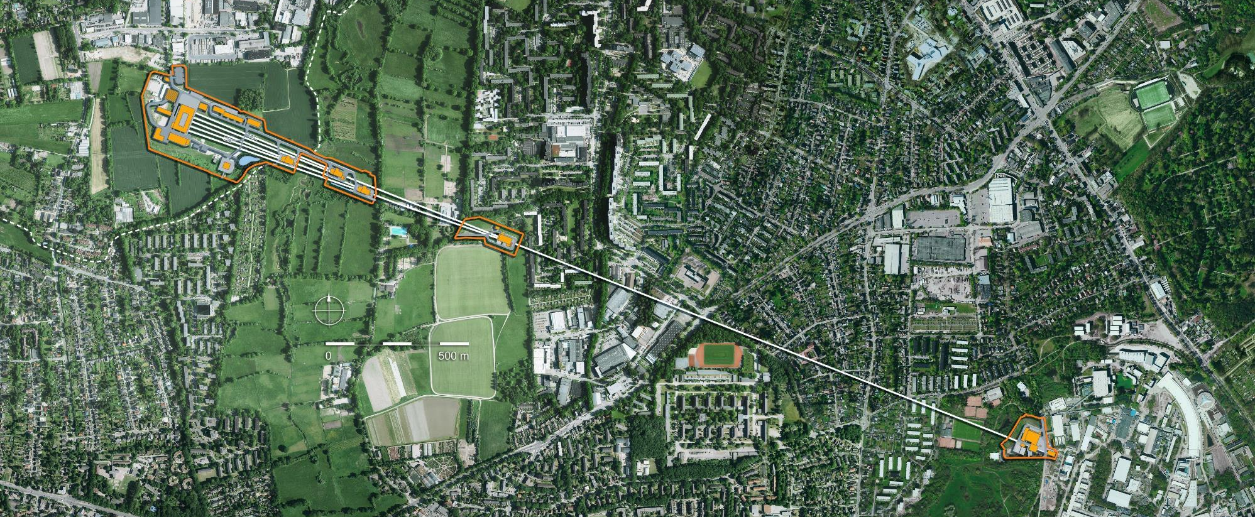

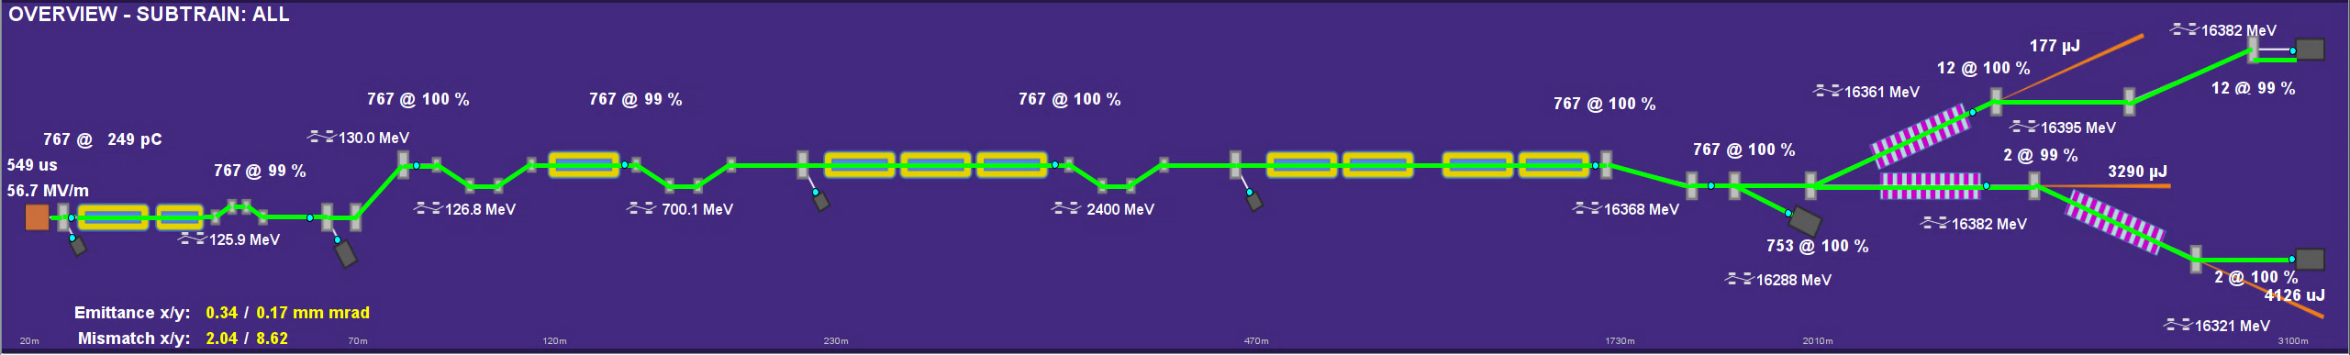
European XFEL
Three SASE undulators
Serving 7 experimental stations
Cover 300 eV to 30 keV photon energies
Hard X-ray self-seeding in SASE2
Two color operation with variable delay in SASE2/SASE3
Short photon pulses
< 1 fs demonstrated at SASE2/SASE3 with TW levels at 9 keV
2-3- fs demonstrated at SASE1
Variable Polarization shown in SASE3

Slide 3
Table of Content
Operations
Statistics
Magnetic Bearings
NEPAL
Automatization
Current developments
Short Pulses
HXRSS
Polarization Control
Towards the future
FALCO
SASE 4/5

Slide 4
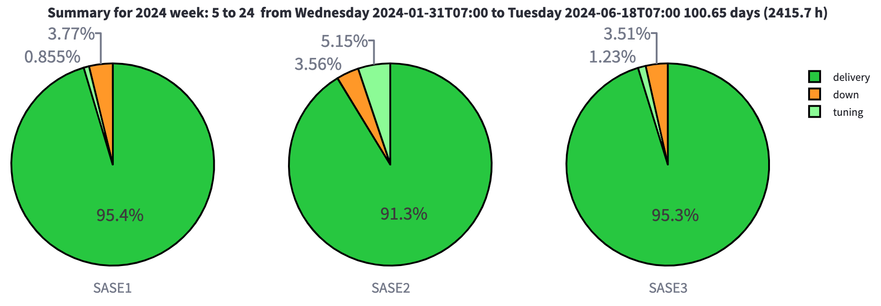
Availability in the last run
17x SASE
9x HXRSS 6x SASE 1x >20keV 1x 2CPP
15x SASE 2x 2CPP

Slide 5
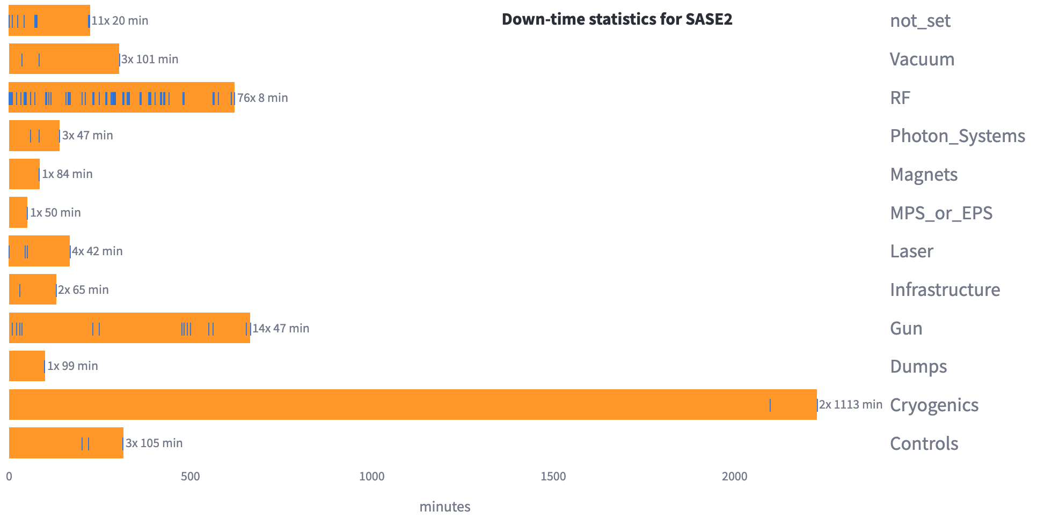
Major contributors for down time

Slide 6
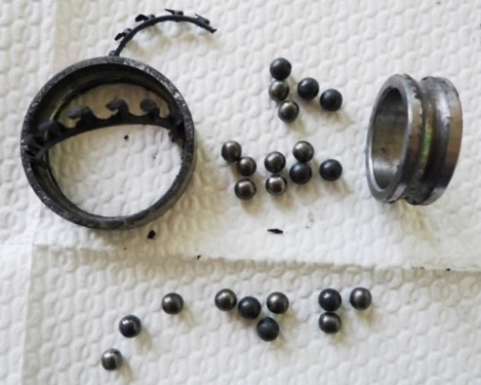
Cold compressor operation: Ceramic ball bearings
32 bearing failures since 2017
- Improvement but no solution
Approach to solving the problem
Design upgrades
Different concepts for equal distribution of forces on bearings
Bearing materials, types and sizes
Cooling concepts, …
- No improvement
Different assembly methods
Establishment of quality management
- No improvement
- Not realistic (time for prototype development)
Change of manufacturer company
- Results not comparable (motors failed “different”)
Tests on warm test stands
Tests on cold test stands
- Not realistic ( > 3 Mio. EUR invest & > 2 years construction time)
AMB motors (active magnetic bearing)
- Not available, in development … for years (at Linde)
- nevertheless 9 bearing failures, no solution
Preventive maintenance (4000 hrs.)
Conclusion
Design upgrades, different procedures and maintenance concepts did not solve the problem
AMB motor is needed (established technology)

Slide 7
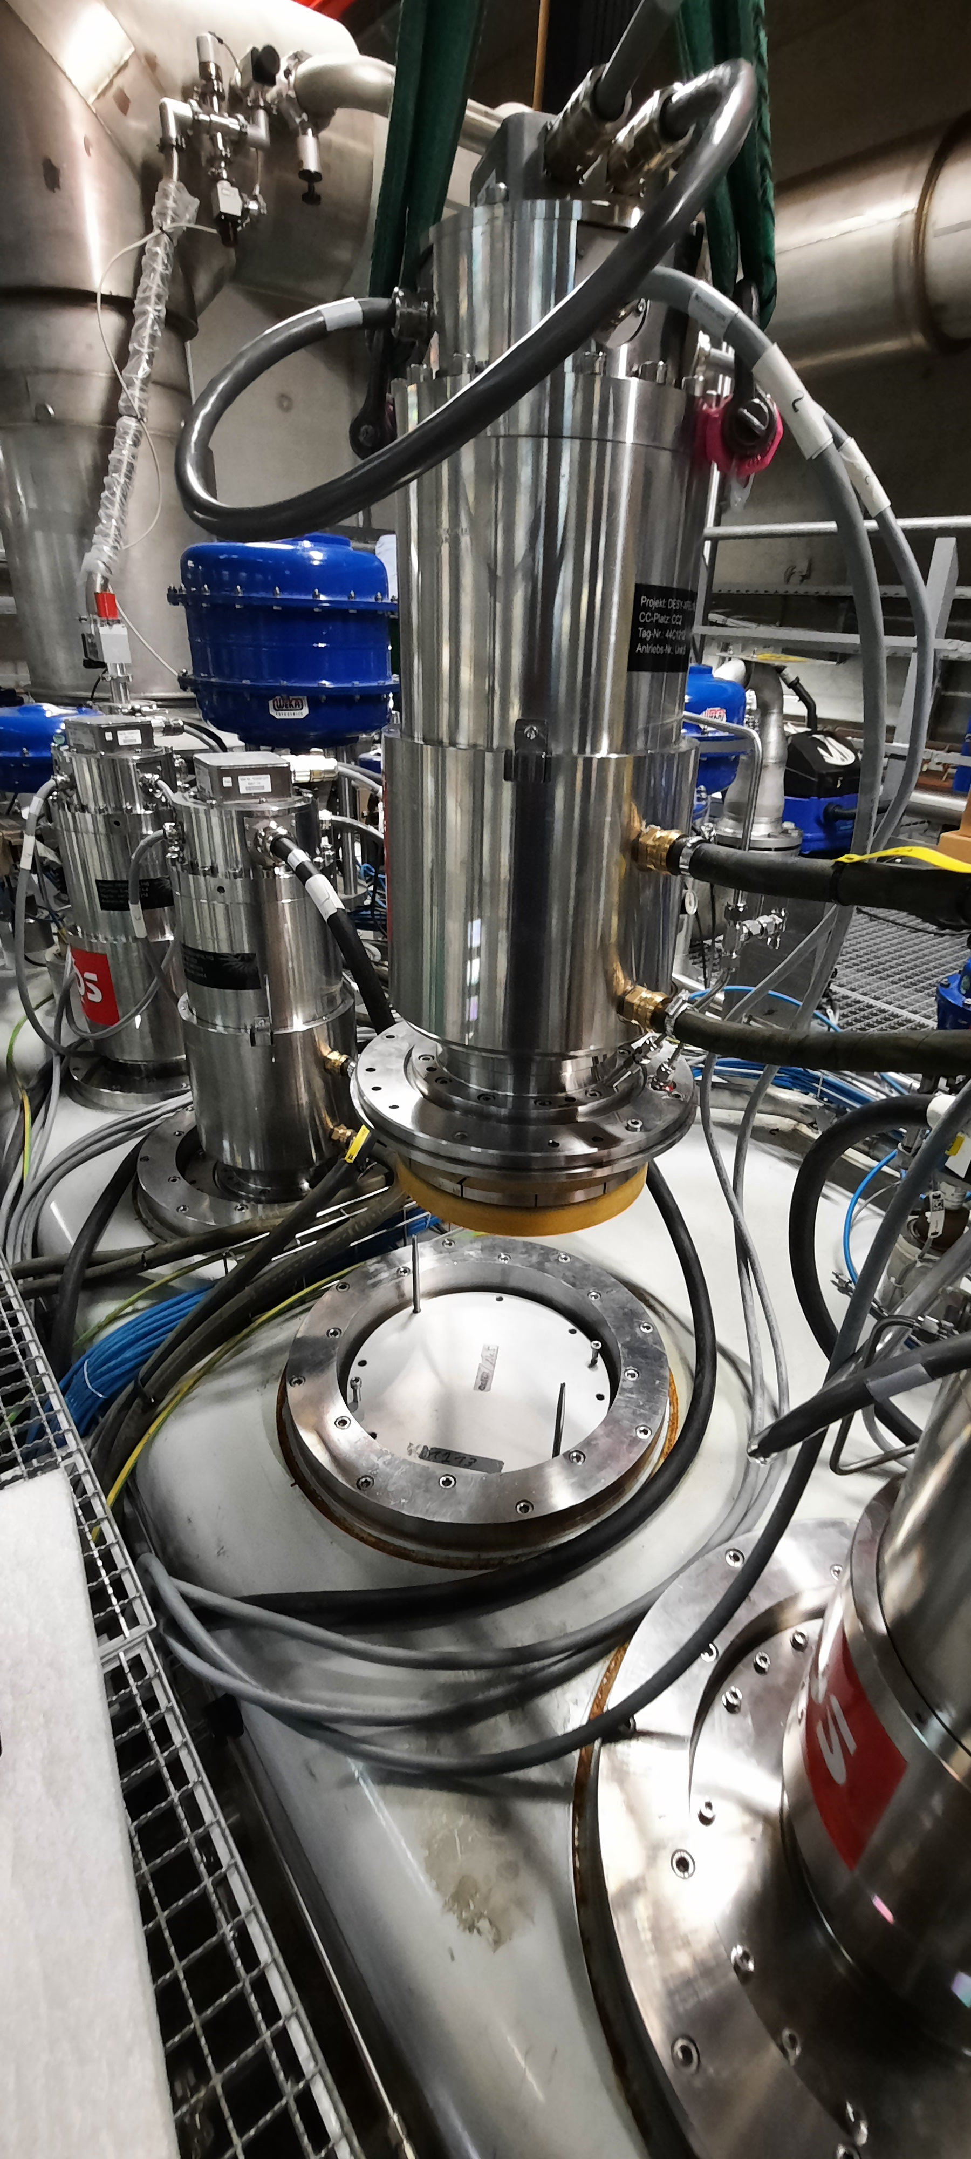
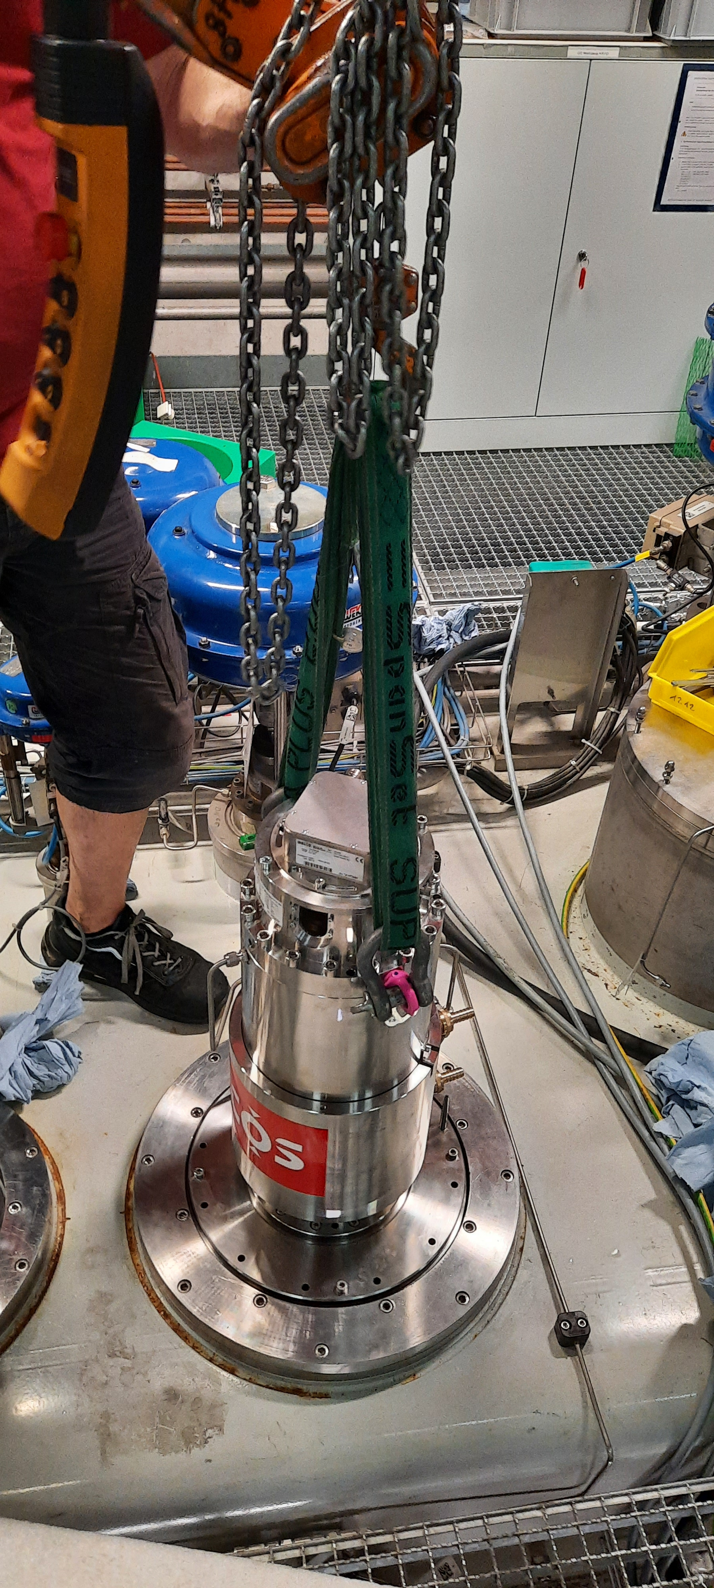
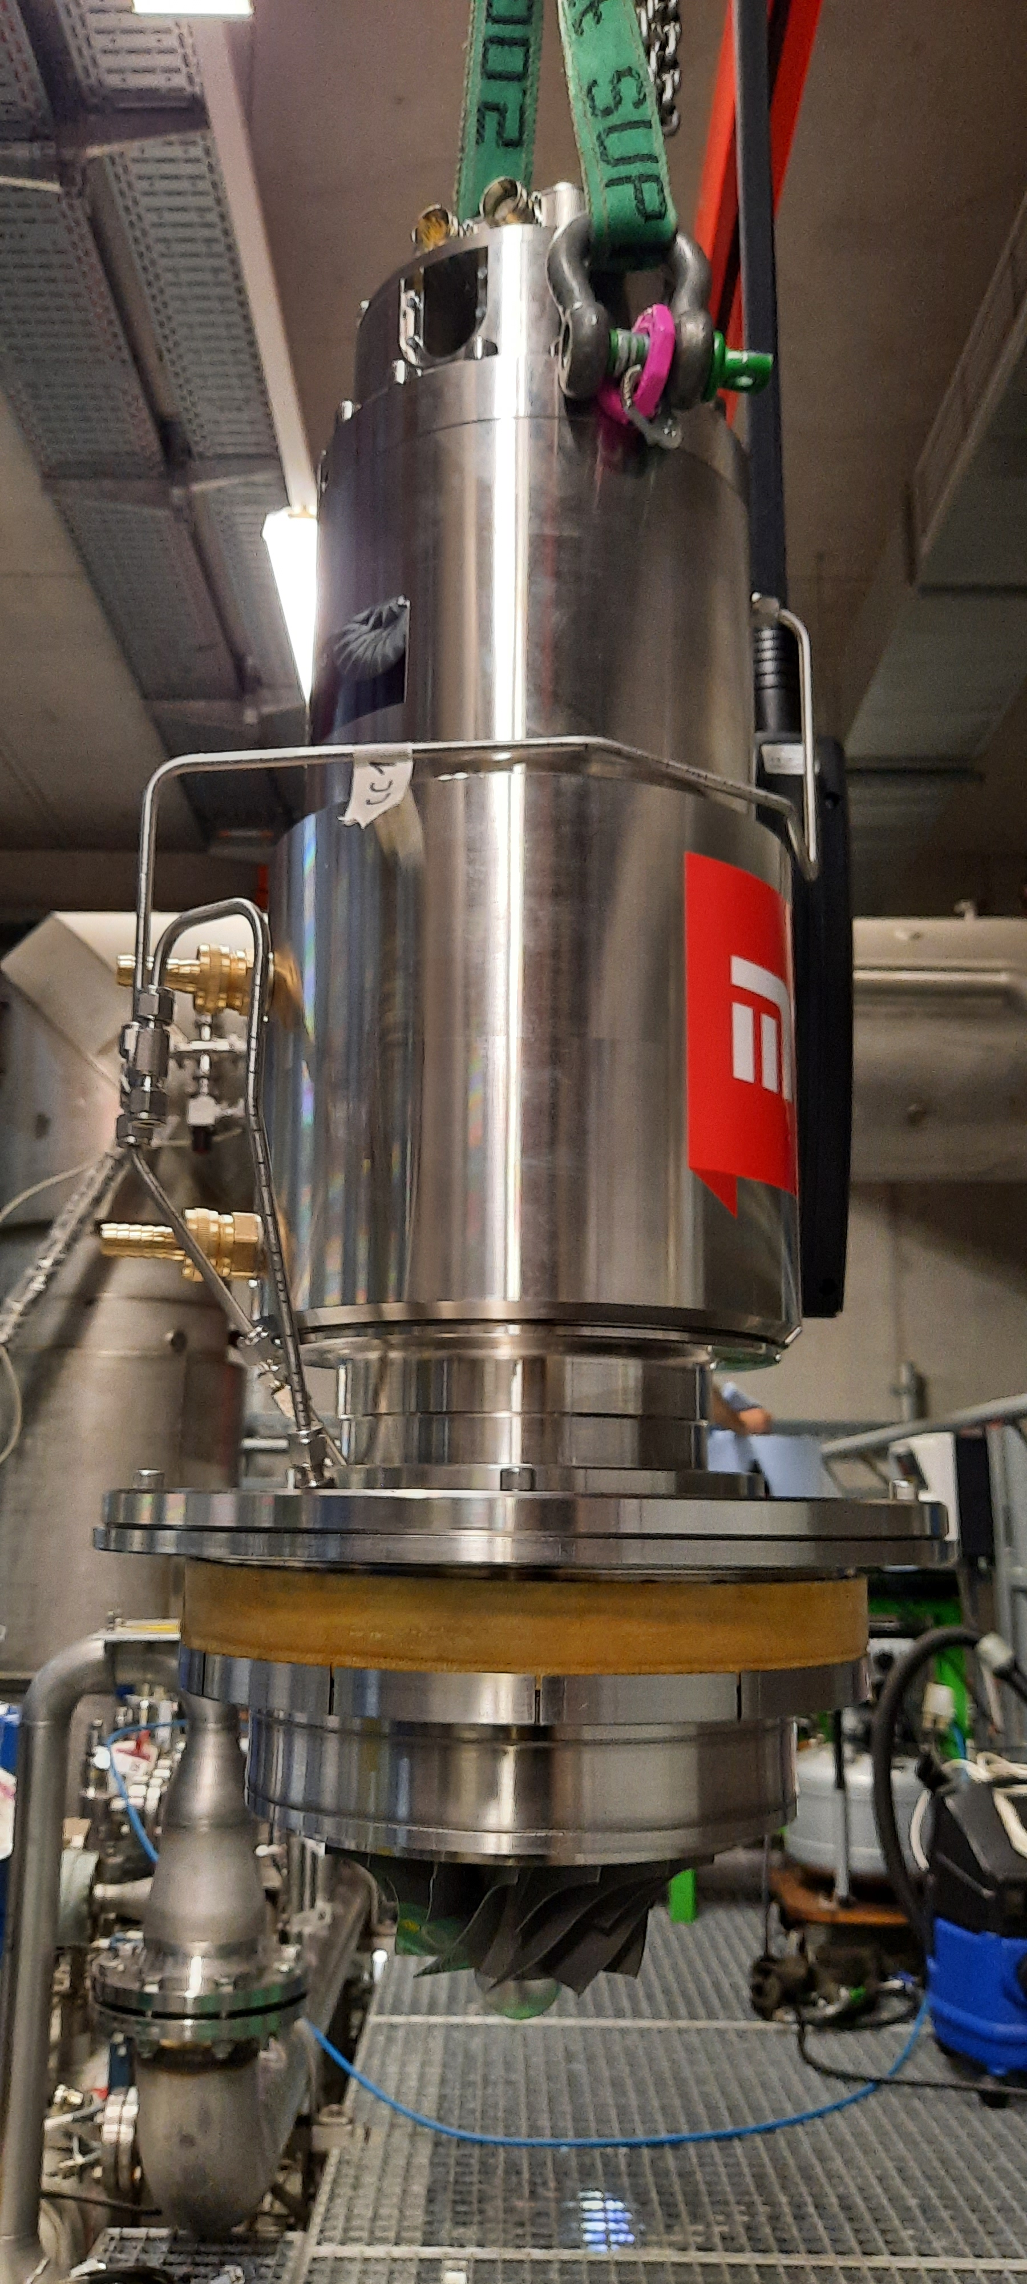
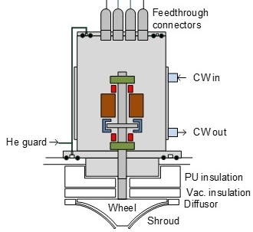
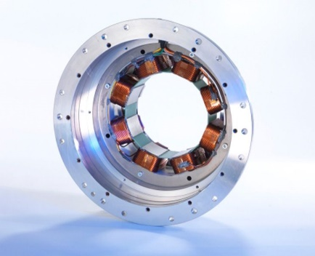
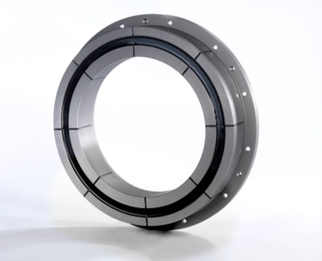
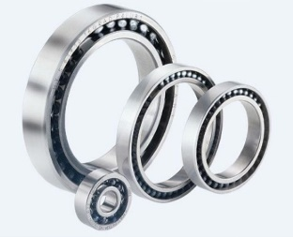
Cold compressor operation: AMB bearings
Conversion from ceramic ball bearings to active magnetic bearings (AMB):
LKT AMB motor (prototype) in operation since Dez. 2022 without serious problems
All four CC stages have been exchanged by LKT AMB motors (still prototypes) and successfully commissioned in June/July 2024
Operating conditions essentially remained the same
Slight modifications on our automation software were necessary
All four stages are running without problems in steady state mode, but…

Slide 8
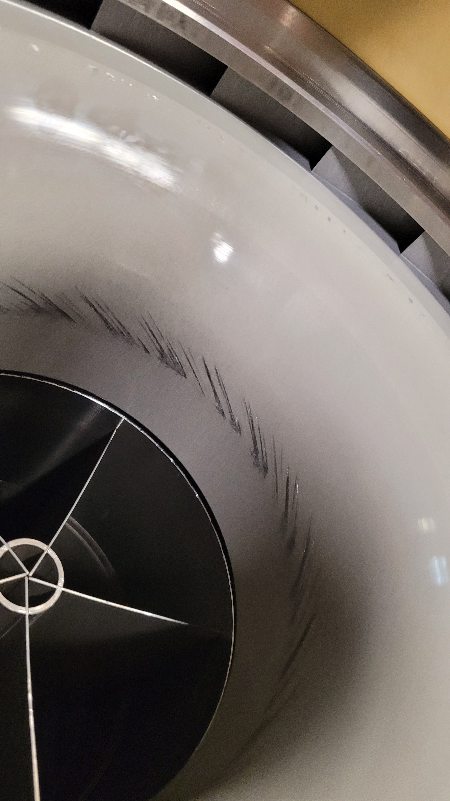
Cold compressor operation: AMB bearings
Remaining problems with new magnetic bearings (AMB):
At least stage 1 - and most likely also stage 2 - shows problems during stopping procedure
Compressor wheel has contact to wheel cover (which may cause serious damage)
Next steps – problem solving:
All motors will be disassembled and surveyed in October 2024
Clearance will be measured thoroughly
Clearance will be corrected in December 2024 if required
Magnet control software for rotor (especially for low frequencies) will be checked and adapted/corrected if required in October 2024
AMP motors are running stable and do not show any problems in steady state mode
Problems during stopping procedure (incl. emergency stops) need to be solved to avoid serious damage
Problem solving starts in October 2024 and will be finished latest in December 2024

Slide 9
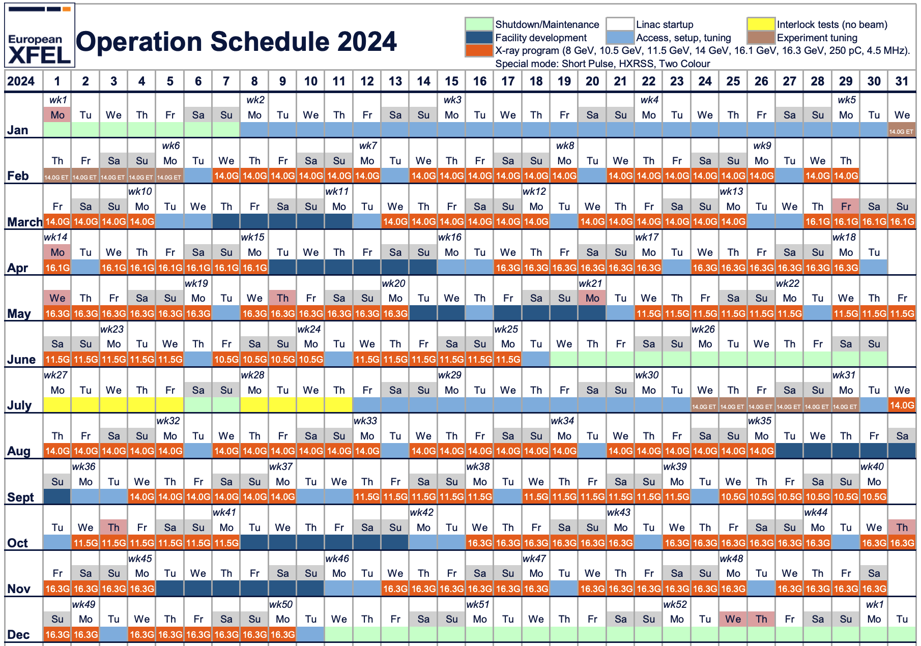
Schedule 2024
Delivery
11x 14 GeV
13x 16.1/16.3 GeV
4x 11.5 GeV
1x 10.5 GeV
Setup & Exp. Tunning
6 Weeks
Facility Development
6 Weeks

Slide 10
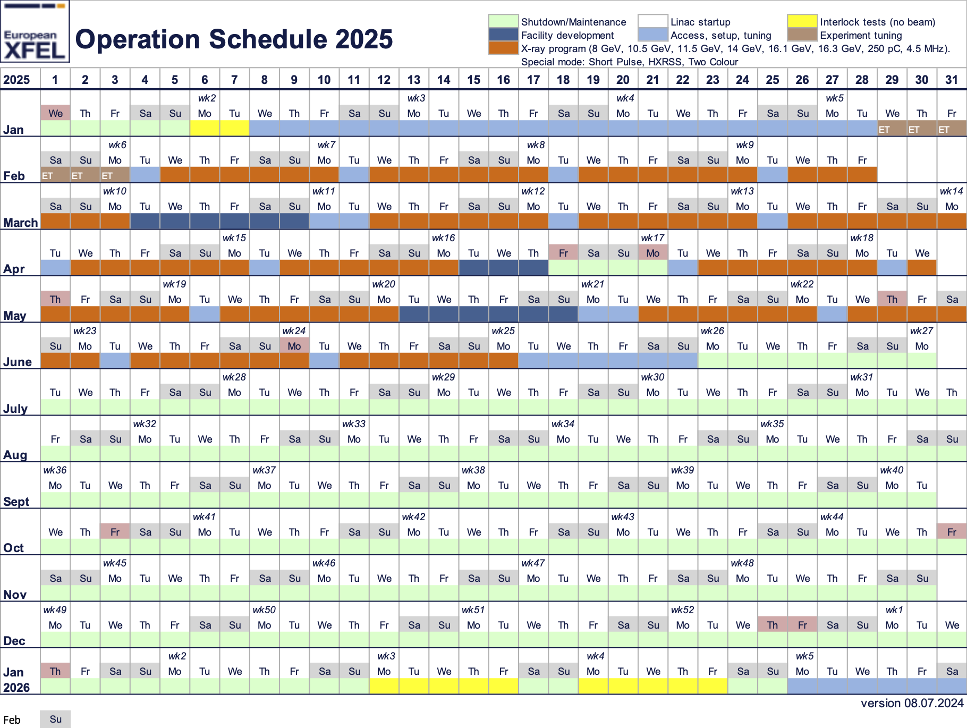
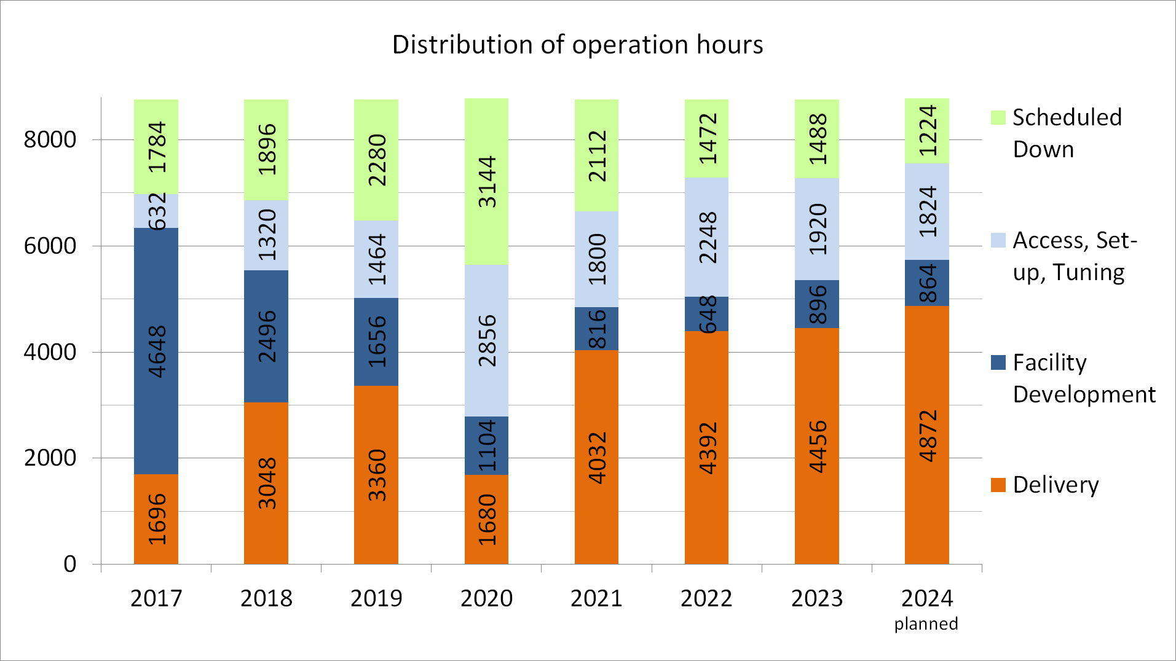
Schedule 2025
Delivery 16 Weeks
Facility Development
2.5 Weeks
Steady increase in delivery hours
Decrease of facility development time
Possible ways to ensure enough FD time
Explore fixed slots within the “weekly” tuning cycle
Explore utilization during the summer maintenance period

Slide 11
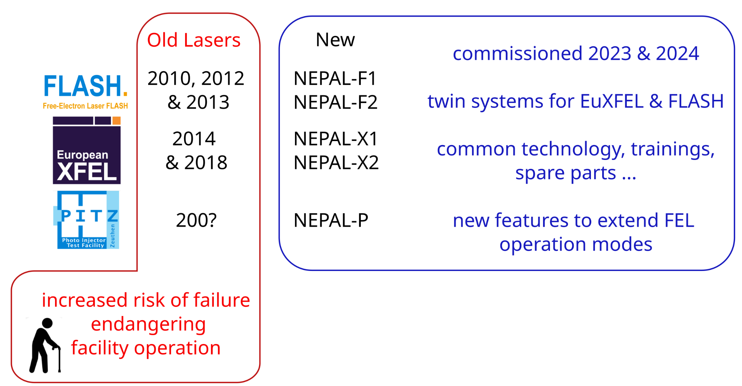
Cathode Laser System
Old laser system reaching end-of-life
Novel system laser system shared by multiple facilities
EuXFEL
FLASH
PITZ?
Increased capability
Temporal shaping
Multiple charges
Multiple pulses
770 ps separation
Same RF bucket

Slide 12
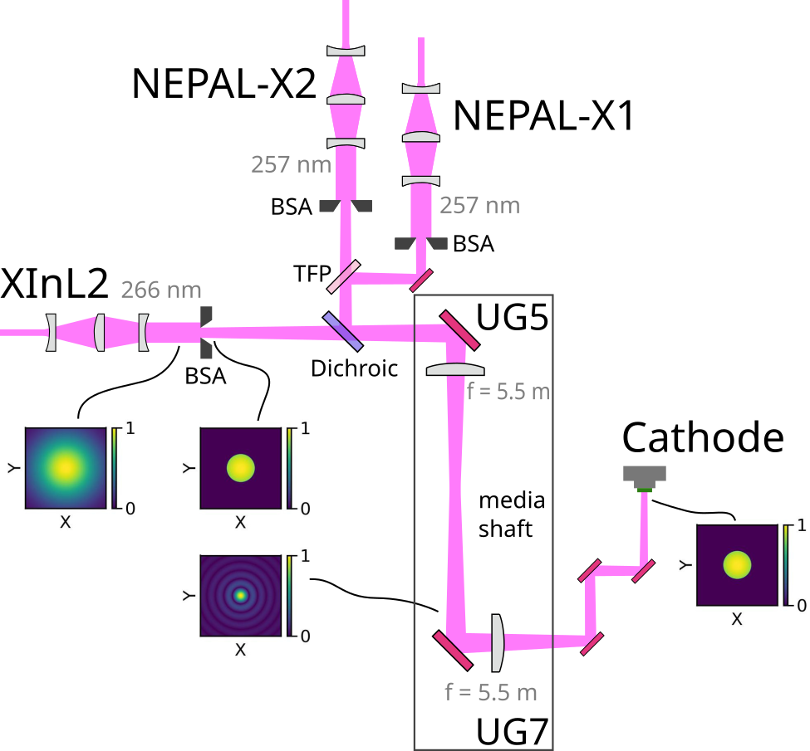
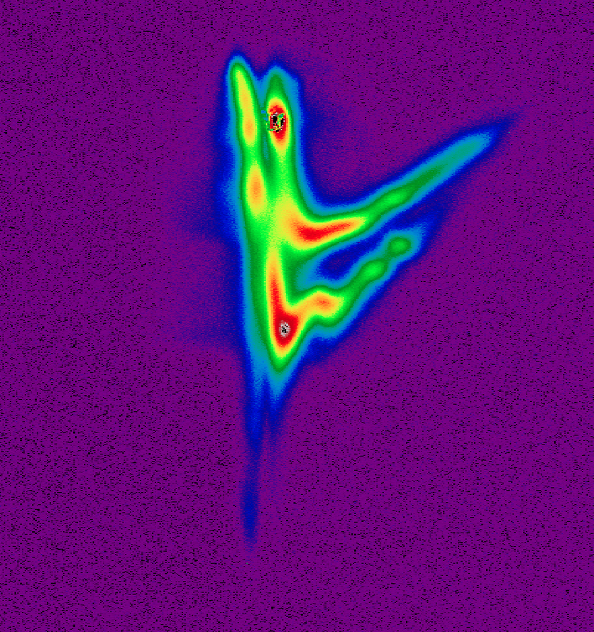
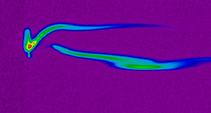
Cathode Laser System
Laser2
Cathode and Laser heater
Nepal X1 (2024
Cathode Laser
Nepal X2 (Since this SS)
Cathode Laser
Allow full control of charge and increased control of longitudinal parameters
OPAL Program
Time
Non-linear scale
770 ps separation
Same RF bucket
Energy

Slide 13
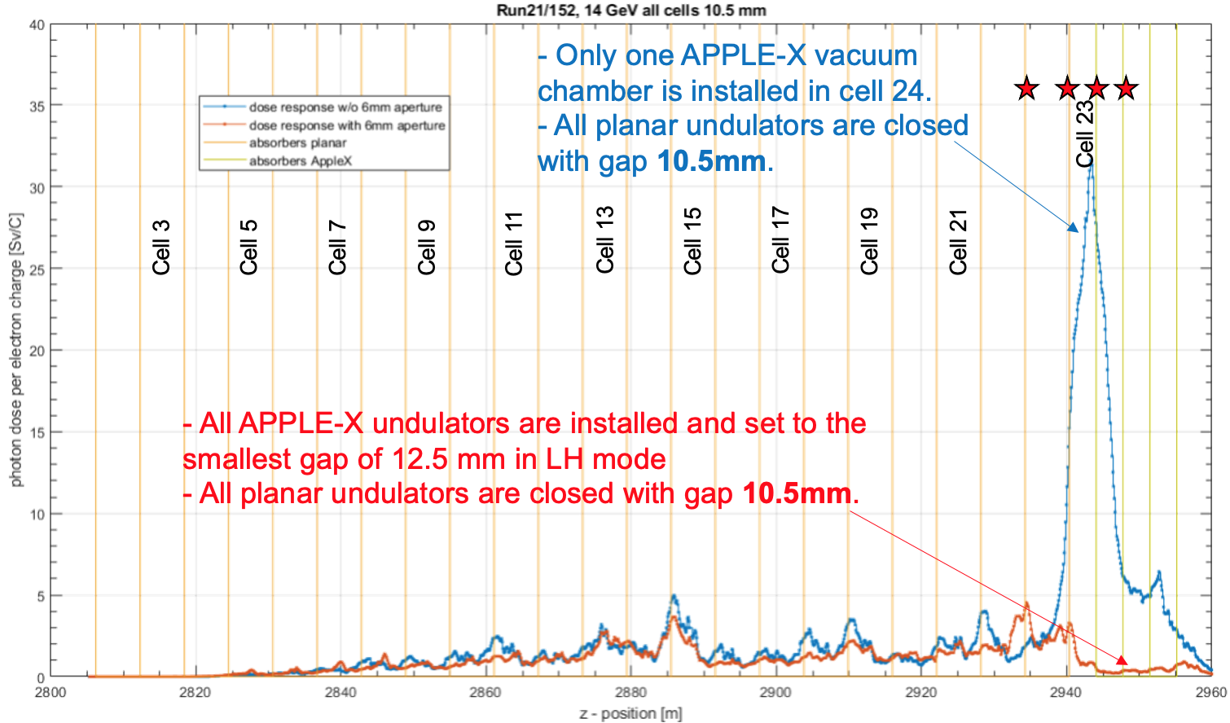
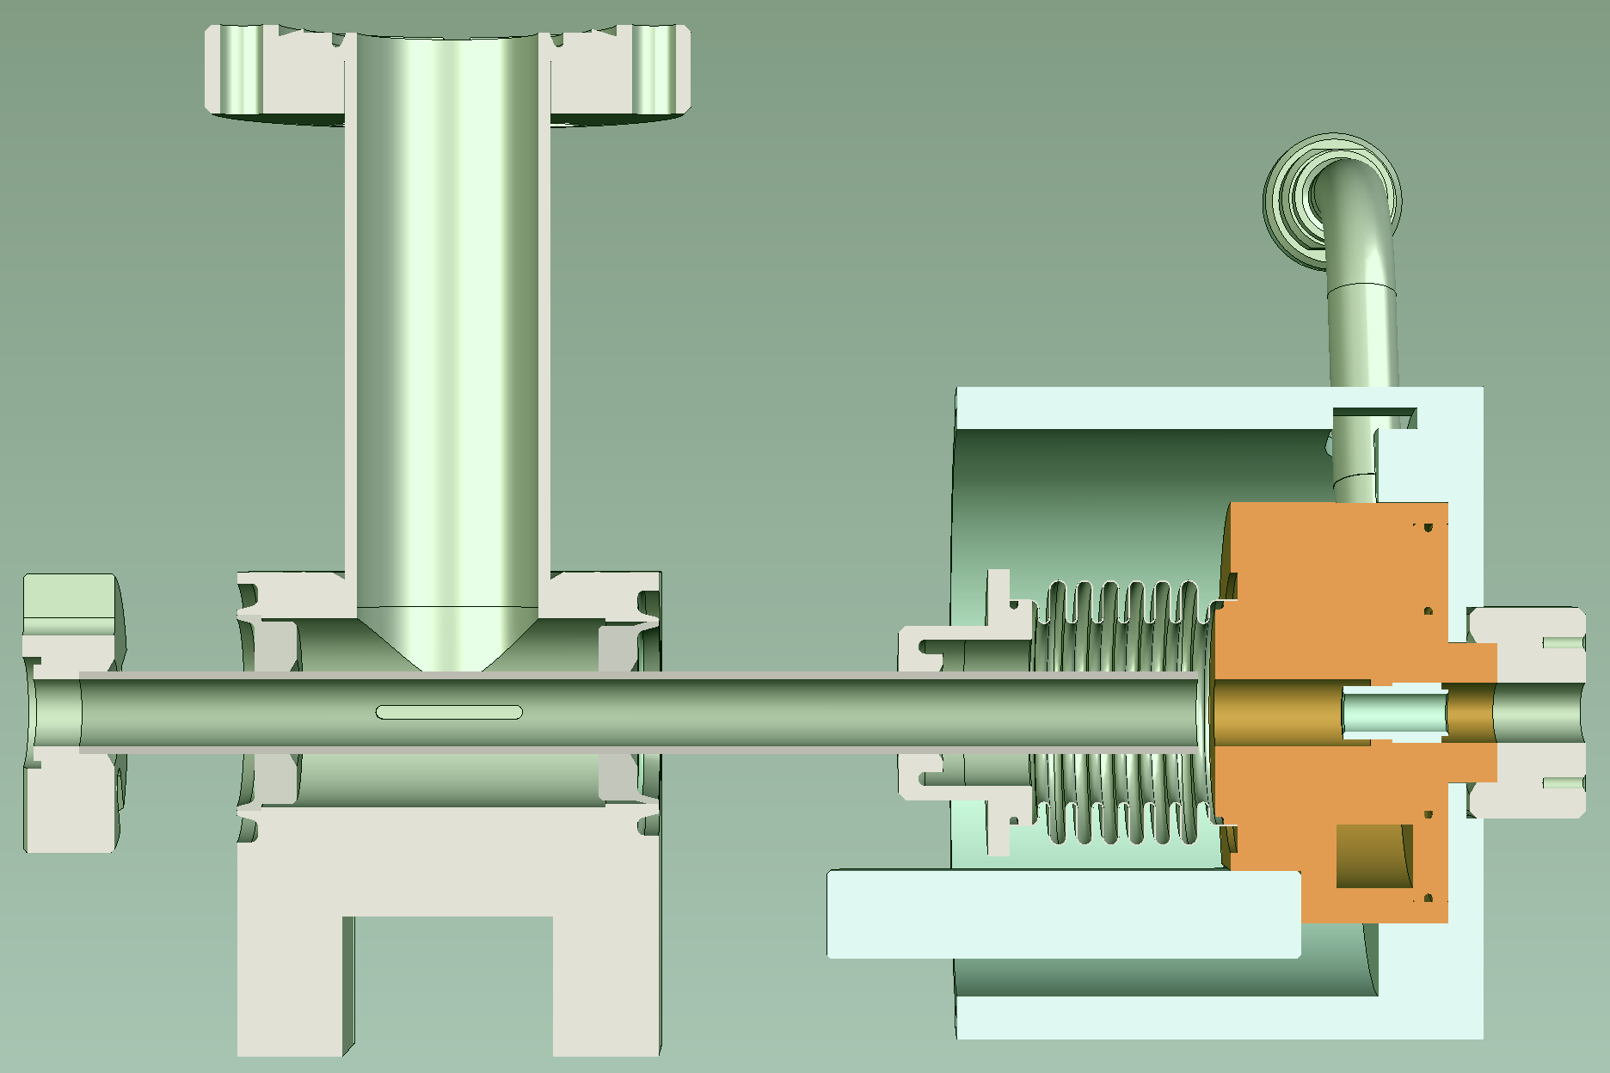
APPLE-X undulators re-installed at SASE3 (Variable Polarization)
Reinstallation of APPLE-X afterburners
Including 4 redesigned absorbers
Designed to shield decoders from spontaneous radiation
Reduction of measured dose rate by two orders of magnitude
Non-
magnetic
tungsten
Lead
shield
⌀6 mm
Beam
15 mm

Slide 14
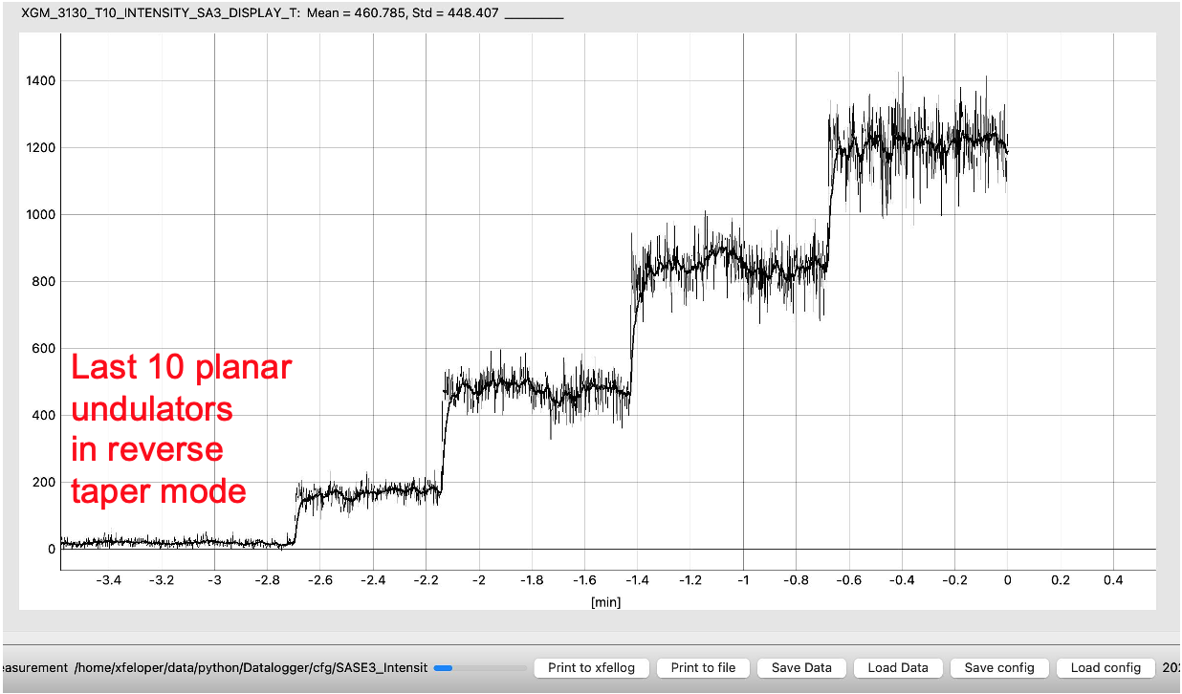
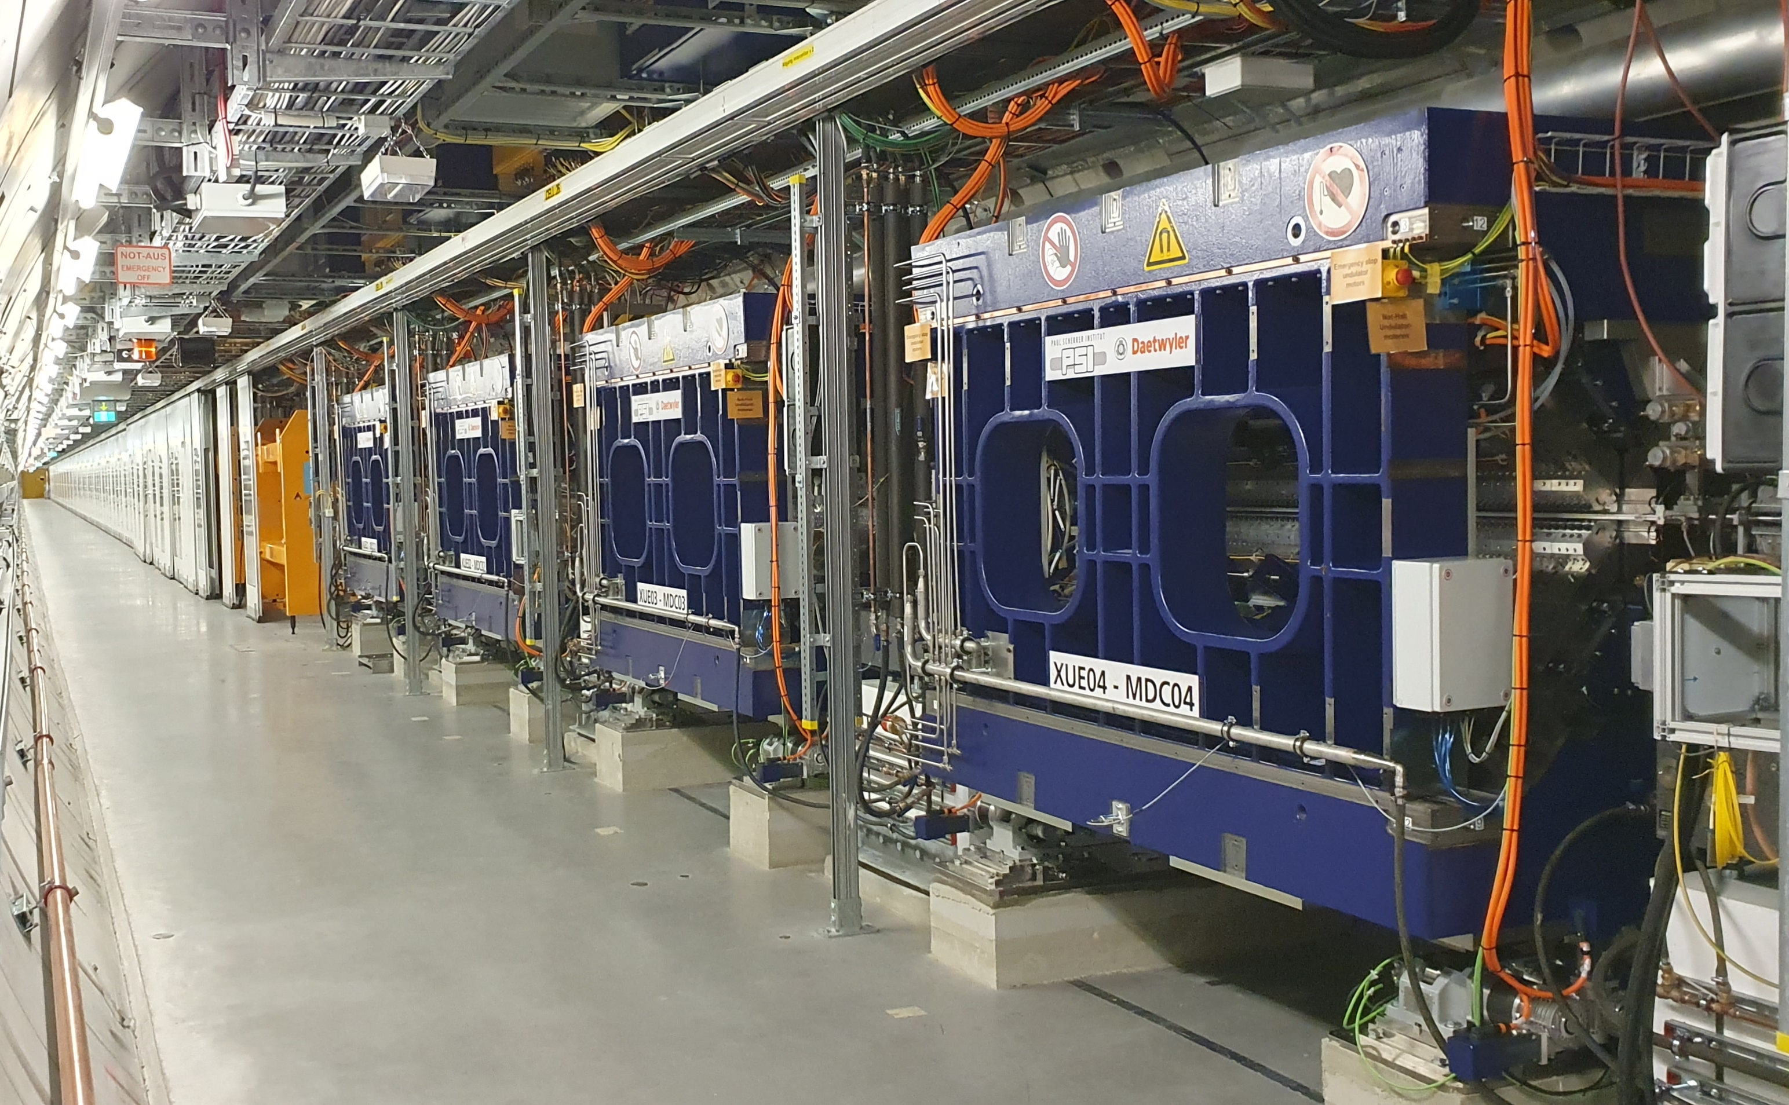
APPLE-X undulators re-installed at SASE3 (Variable Polarization)
Measurement with MARWIN4 robot, carrying a photon and
neutron dose rate meter LB 6419: After the redesign and the installation of 4 absorbers ( ), a reduction of radiation in the afterburner area by a factor of ~100 was achieved.
Achieved circular polarization with all four undulators
>95% circular polarization
1.2 mJ at 1 keV
Reproducible results
Already delivered to users
High level software exists for operations
Alignment strategy still in the improvement process
1 .. 2 .. 3 .. 4
Apple-X undulators closed
First lasing (25.01.2024 22:00)

Slide 15
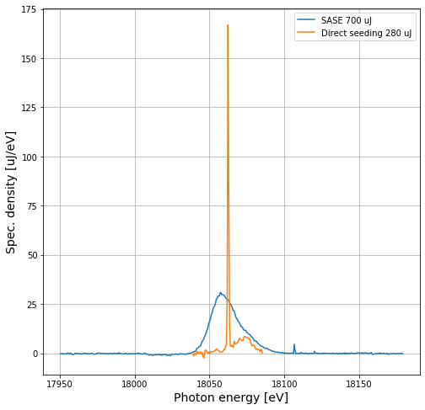
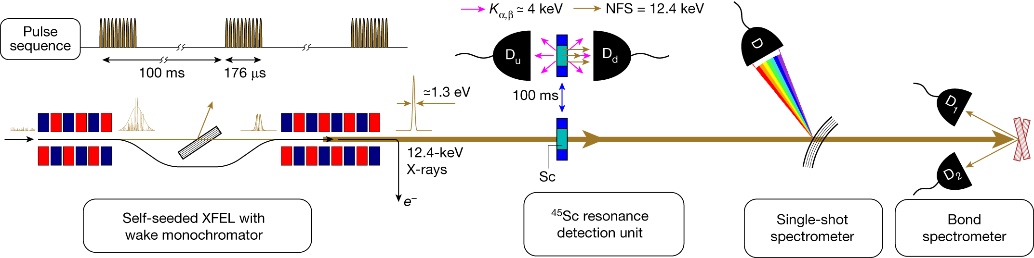
High Repetition Rate HXRSS
HXRSS for very hard x-rays
Small cross-section and lower spectral density
High repetition rate increases statistics
Beam quality along the pulse train of crucial importance
Stabilization by feedbacks (pilot pulses)
SASE2 regularly delivers hundreds of pulses per train
Was used for several high impact experiments
⁴⁵Sc Nuclear Resonance with a natural linewidth 1.4 feV (12.4 keV)
Resonant X-ray excitation of the nuclear clock isomer 45Sc, Y Shvydo’ko et al, Nature 622, 471-475 (2023)

Slide 16
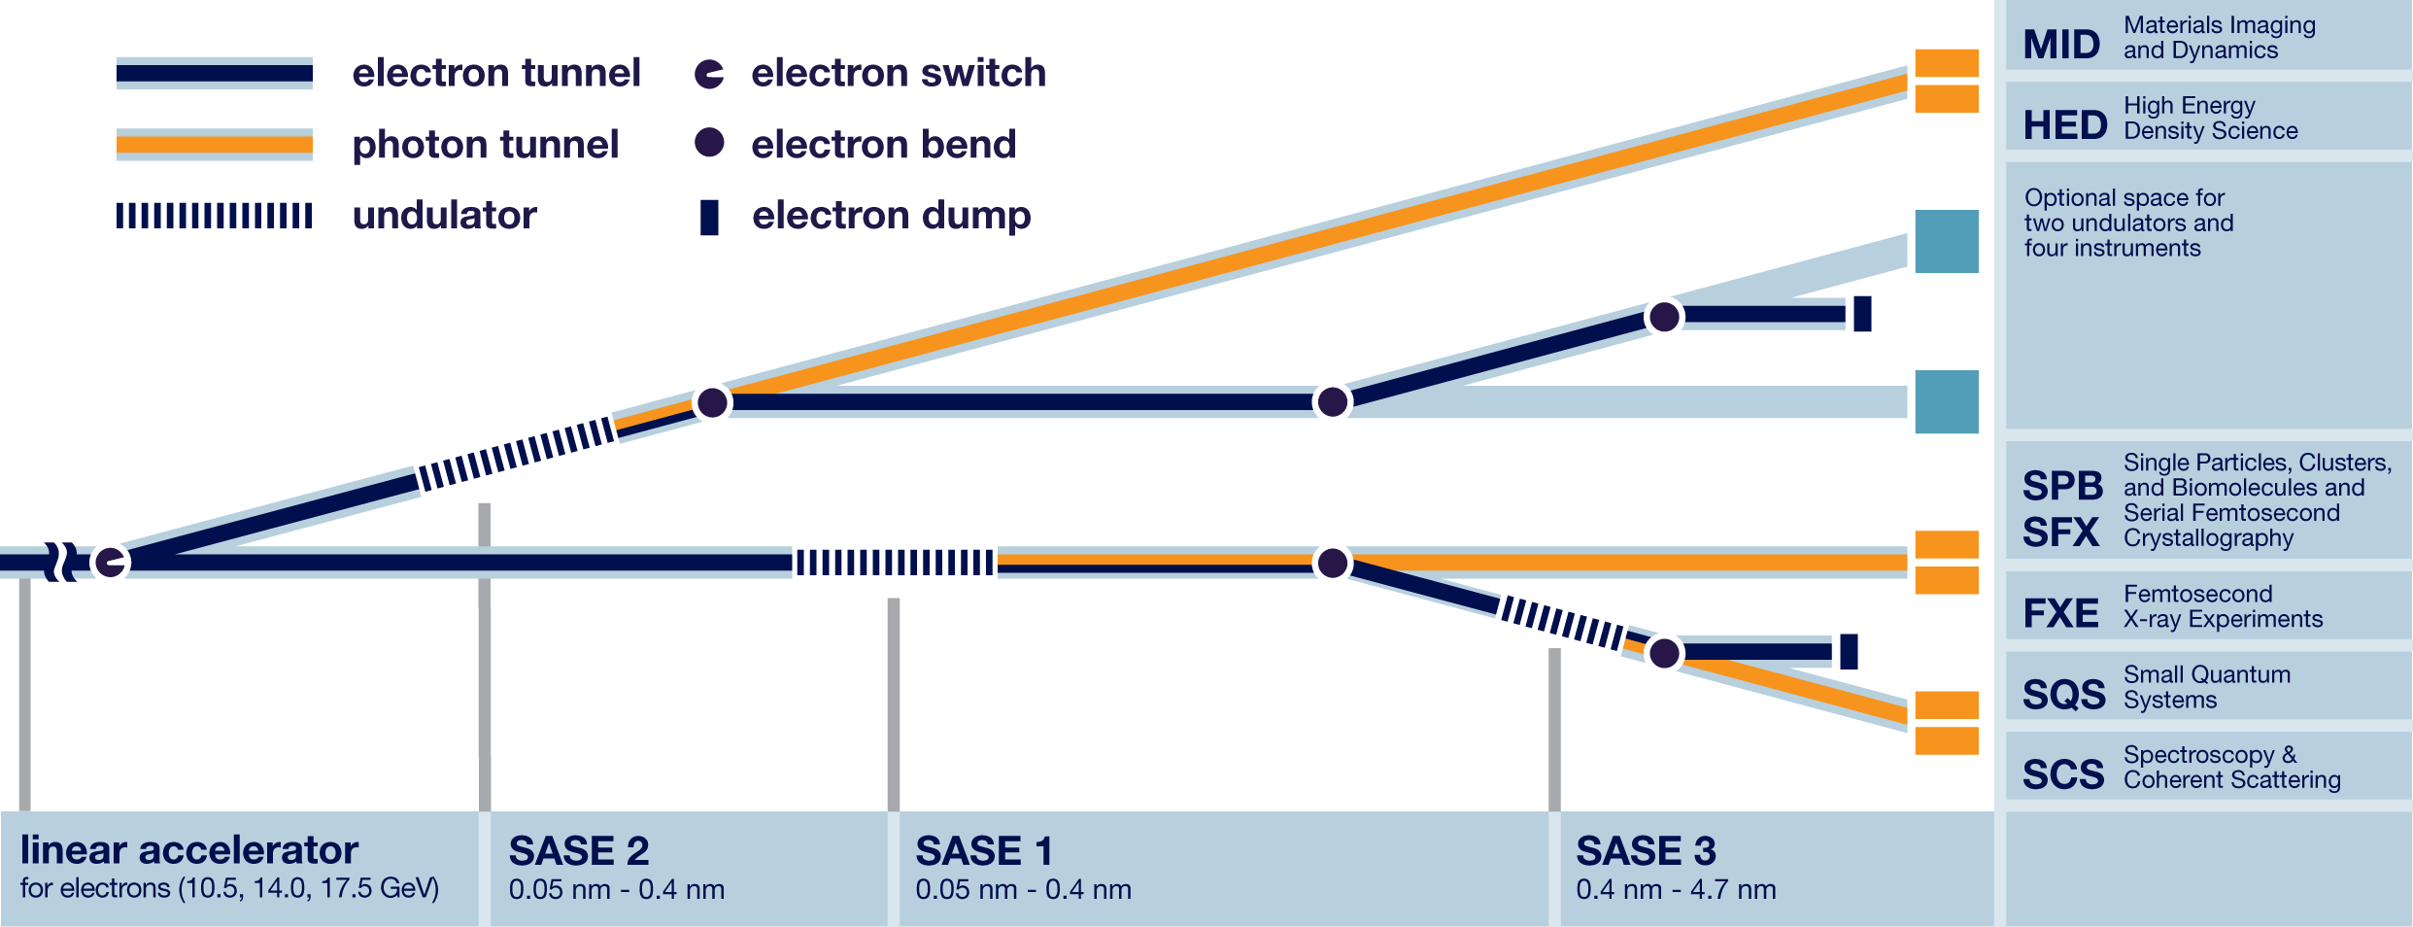
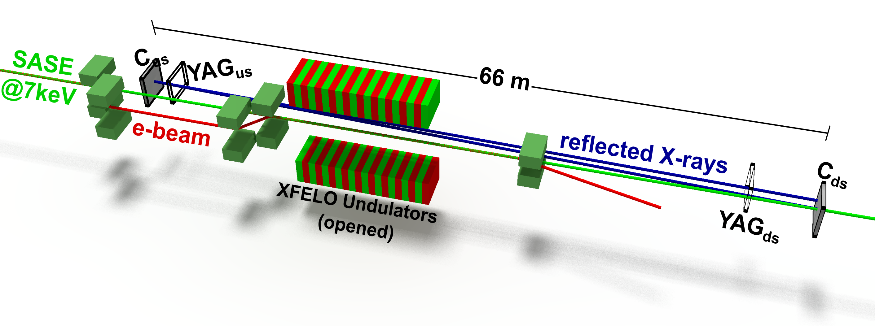
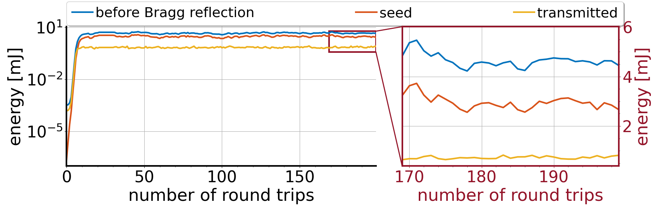
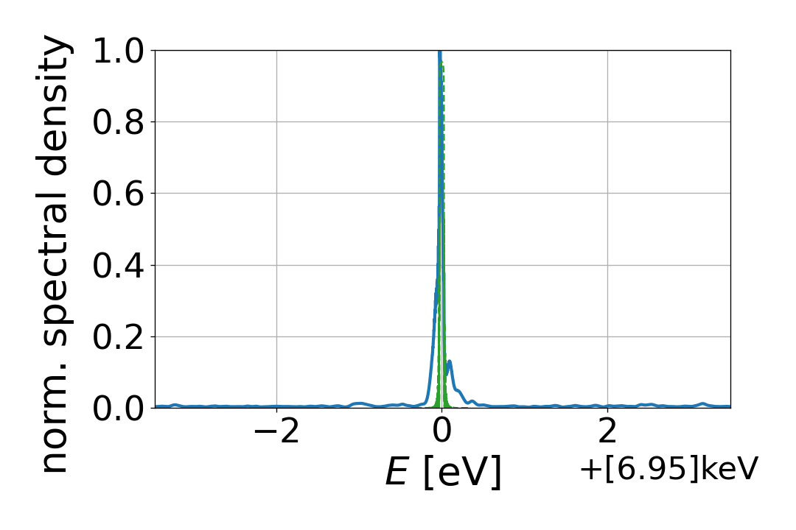
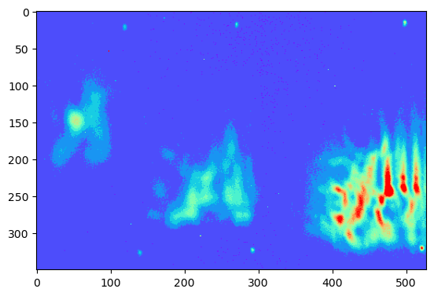
Cavity Based XFEL at EuXFEL (XFELO)
CBXFELs promise outstanding radiation characteristics
Orders of magnitude higher peak spectral flux than SASE
Higher shot to shot stability than Self-Seeding
Commissioning of CBXFEL demonstrator at EuXFEL started
Fixed photon energy at 7keV
Diamond Bragg reflectors
KB mirrors with curvature for focusing to be installed as we speak
CBXFEL
First results: three roundtrips:
6th
4th
2nd

Slide 17
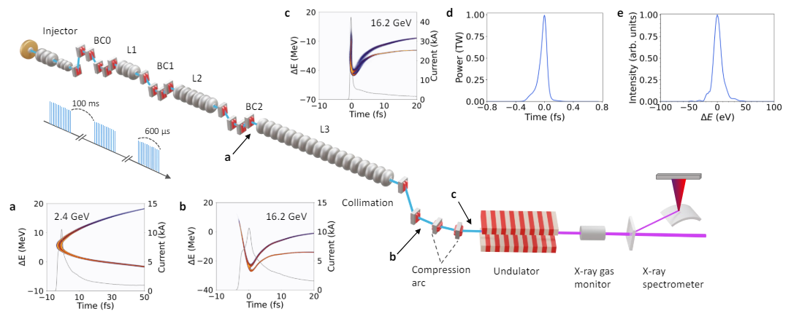
Atto-Second Pulse Generation utilizing Self-Chirping Method
Slide curtesy of Jiawei Yan

Slide 18
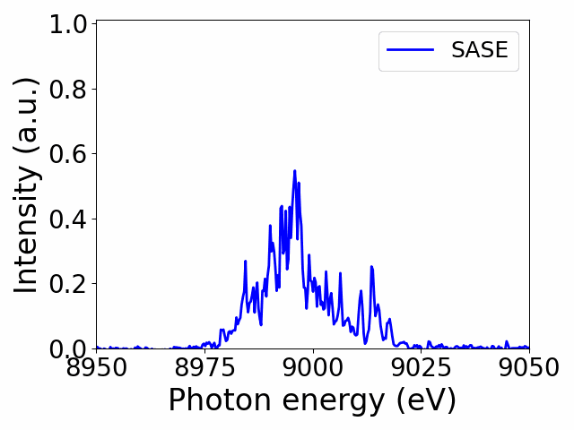
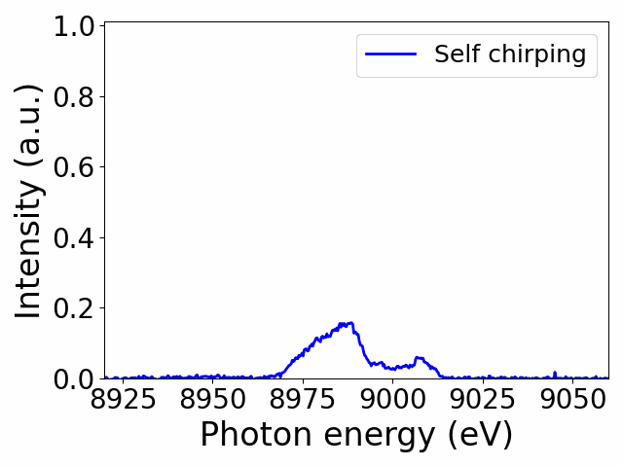
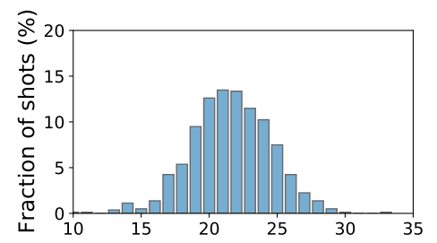
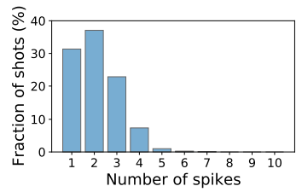
Atto-Second Pulse Generation utilizing Self-Chirping Method
This method is not repetition rate limited
This method allows for reliable short pulse production
Works both for SXR and HXR
Has been delivered to SXR users several times
Incl. Angular streaking
Ongoing effort to further improve performance
Wavelength range
Single Shot fraction
Nominal Performance
Short Pulse Performance
2172 ± 84 𝜇J
174 ± 23 𝜇J
Slide curtesy of Jiawei Yan

Slide 19
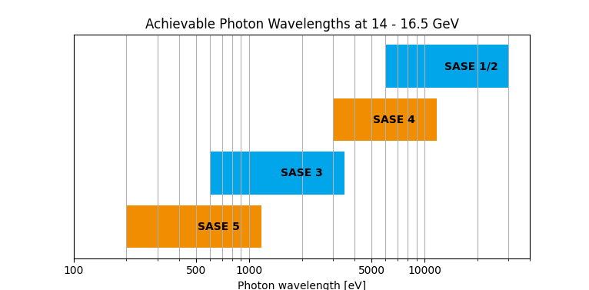
Possible Extension: SASE4 & SASE5
Possible mid-term upgrade: SASE 4 & SASE 5
About 100 m per undulator line
Reserved space for experimental hutches exists
Allows for continuous photon energy coverage
Synergies with the high duty cycle upgrade but does not require it
Decremental effects beam transport are studied
Spontaneous radiation
Transport through arcs
More effort is required to develop the extended parallel operation of all SASE lines
Cross talk
Individual compression
Spontaneous radiation

Slide 20
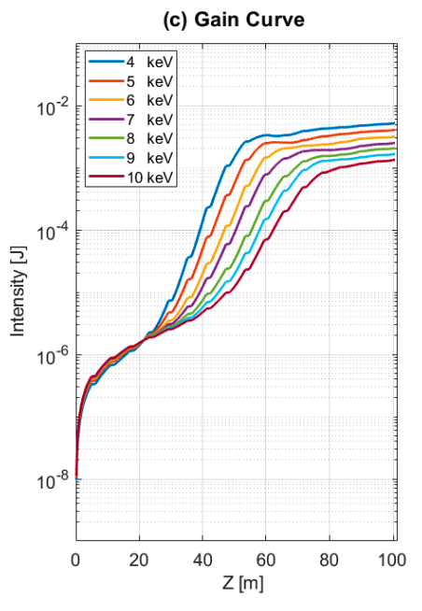
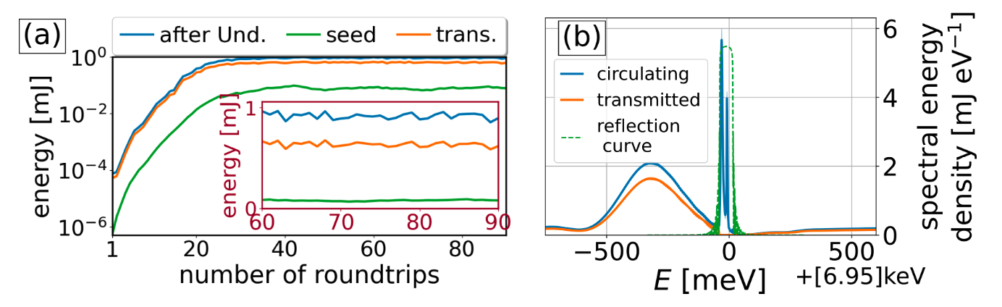
Possible Extension: SASE4 & SASE5
Standard SASE is studied
Saturation is reachable
Would allow for very intense soft x-ray machine (200 eV)
Atto-second pulse production
Current developments would be compatible with this operation
Though two pulses will be limited (small undulator length)
Coherence control
Self and external seeding has been studies
Could be an interesting case for a cavity based system (requires more studies)

Slide 21
Summary
EuXFEL availability ~95% availability
Main contributor: ceramic bearings of cold boxes – have been replaced by magnetic ones (no failure since)
Steady increase of user delivery hours
The low facility development hours are starting to be hindering progress
Ongoing developments
Beam shaping (Pulse duration, coherence, polarization)
Automation
Longterm developments for more beam lines SASE 4&5
Additional Topics (Backup slides)
High Duty cycle upgrade
FALCO gun development
Automatization of the accelerator operation

Slide 22
Backup Slides

Slide 23
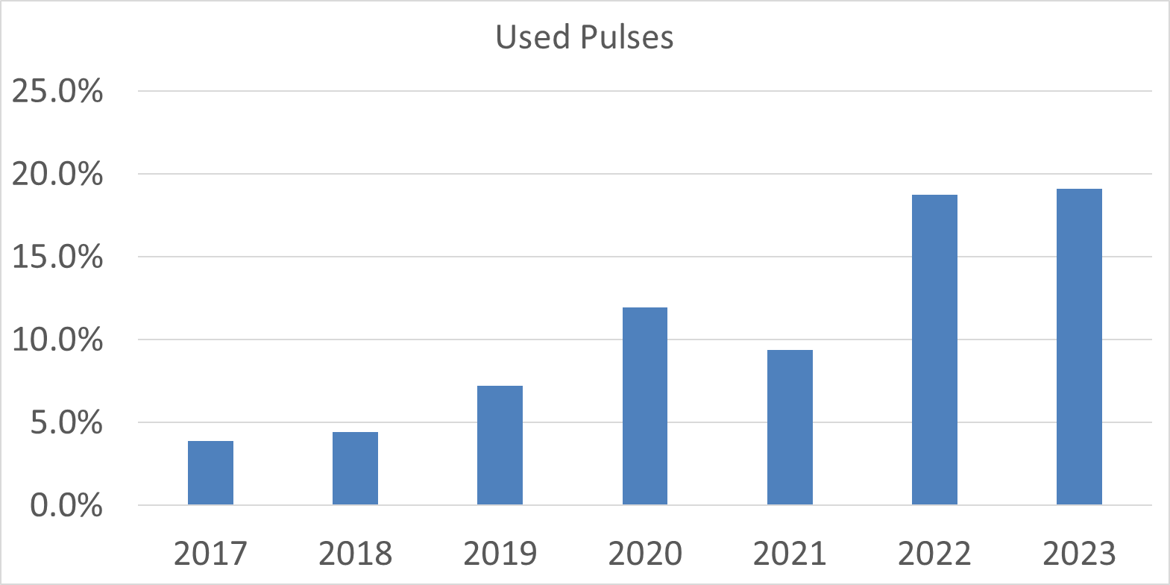
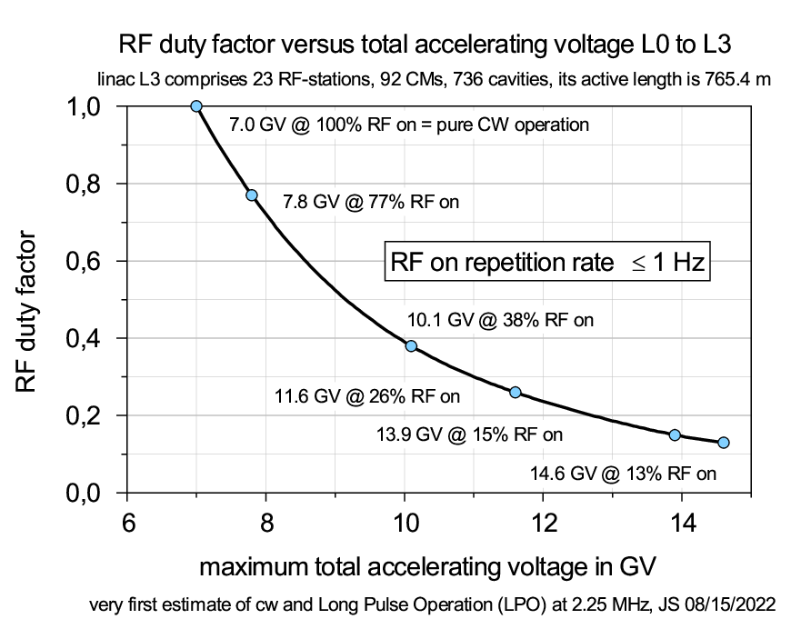
EuXFEL – High Duty Cycle Upgrade
Current burst pattern
4.5 MHz internal repetition rate
Increasable to 9 MHz with minor investments
Seldomly fully utilized
RF window is about 600 µs
The new Gun5 (2025 Q2) increases RF window to 800 µs
Allows to operate the full energy range
Any further increase of the RF window will require substantial investments
Refurbishments of cryo modules
Addition of 4 cryo strings
Reduces train repetition rate to 1 Hz
Reduces electron energy
Keeping flexibility for each beam line will be a challenge
A second injector would increase individual beam shaping capabilities

Slide 24
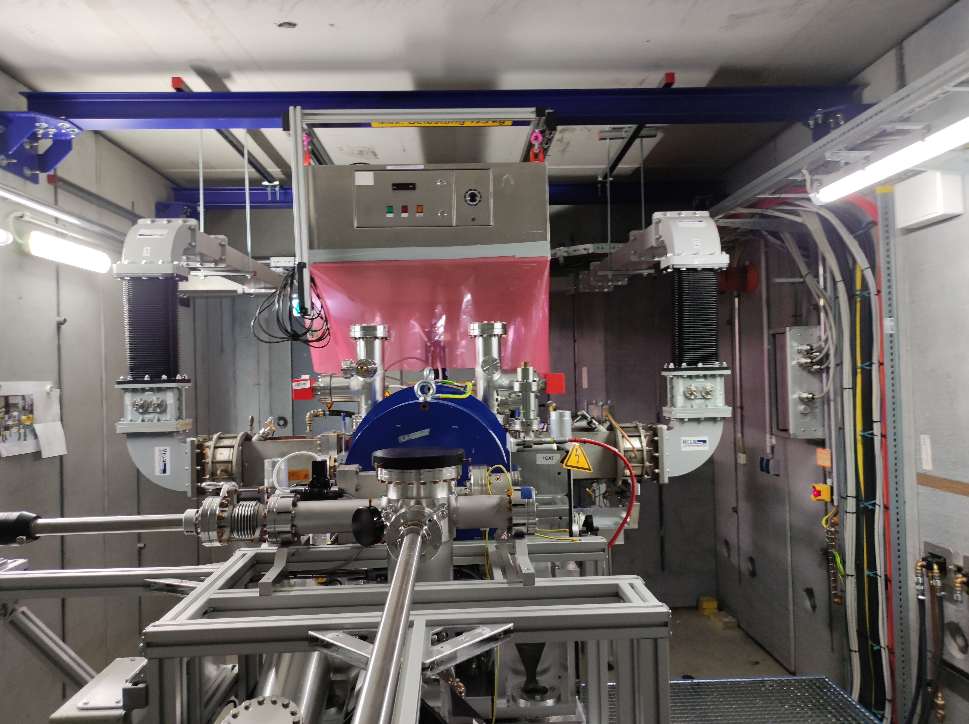
Gun5
Our gun is limited by arcing events of the singe RF window
The novel gun utilizes two RF windows
Allows for significant increase of the RF window
Same design as for FLASH to maximize synergies

Slide 25
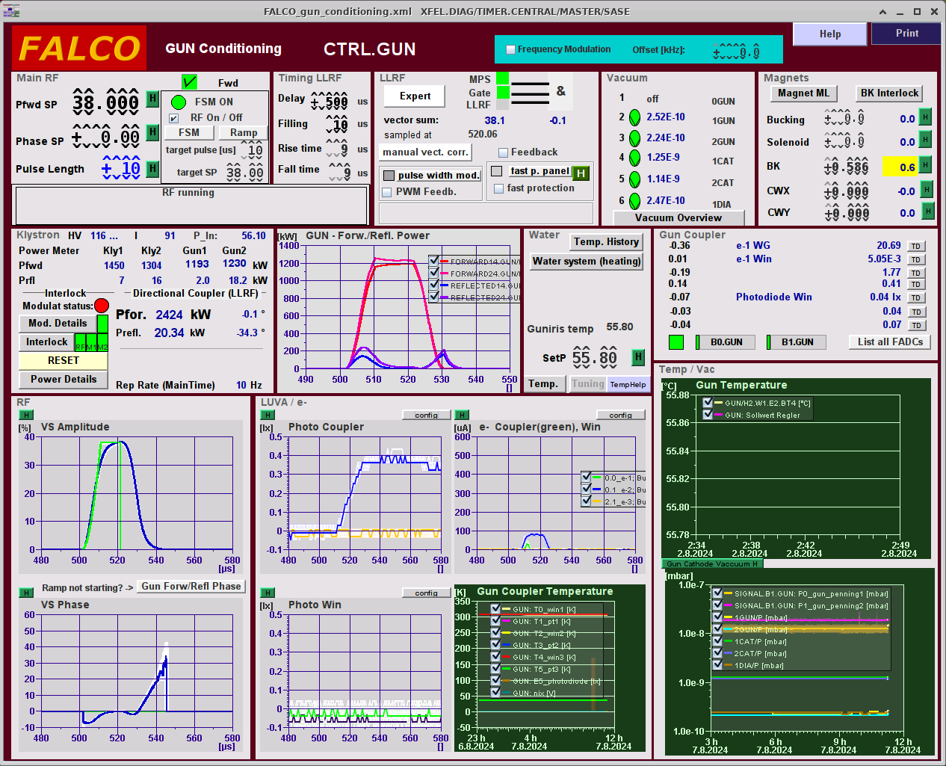
Symmetric Input
56° Resonance Temperature
Signal from Gun pickup

Slide 26
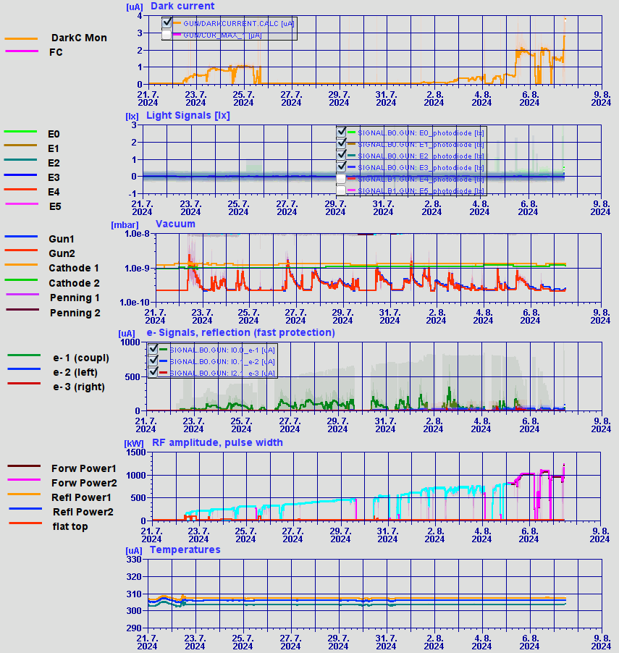
Progress of short pulse conditioning (10 µs) during first 2 weeks

Slide 27
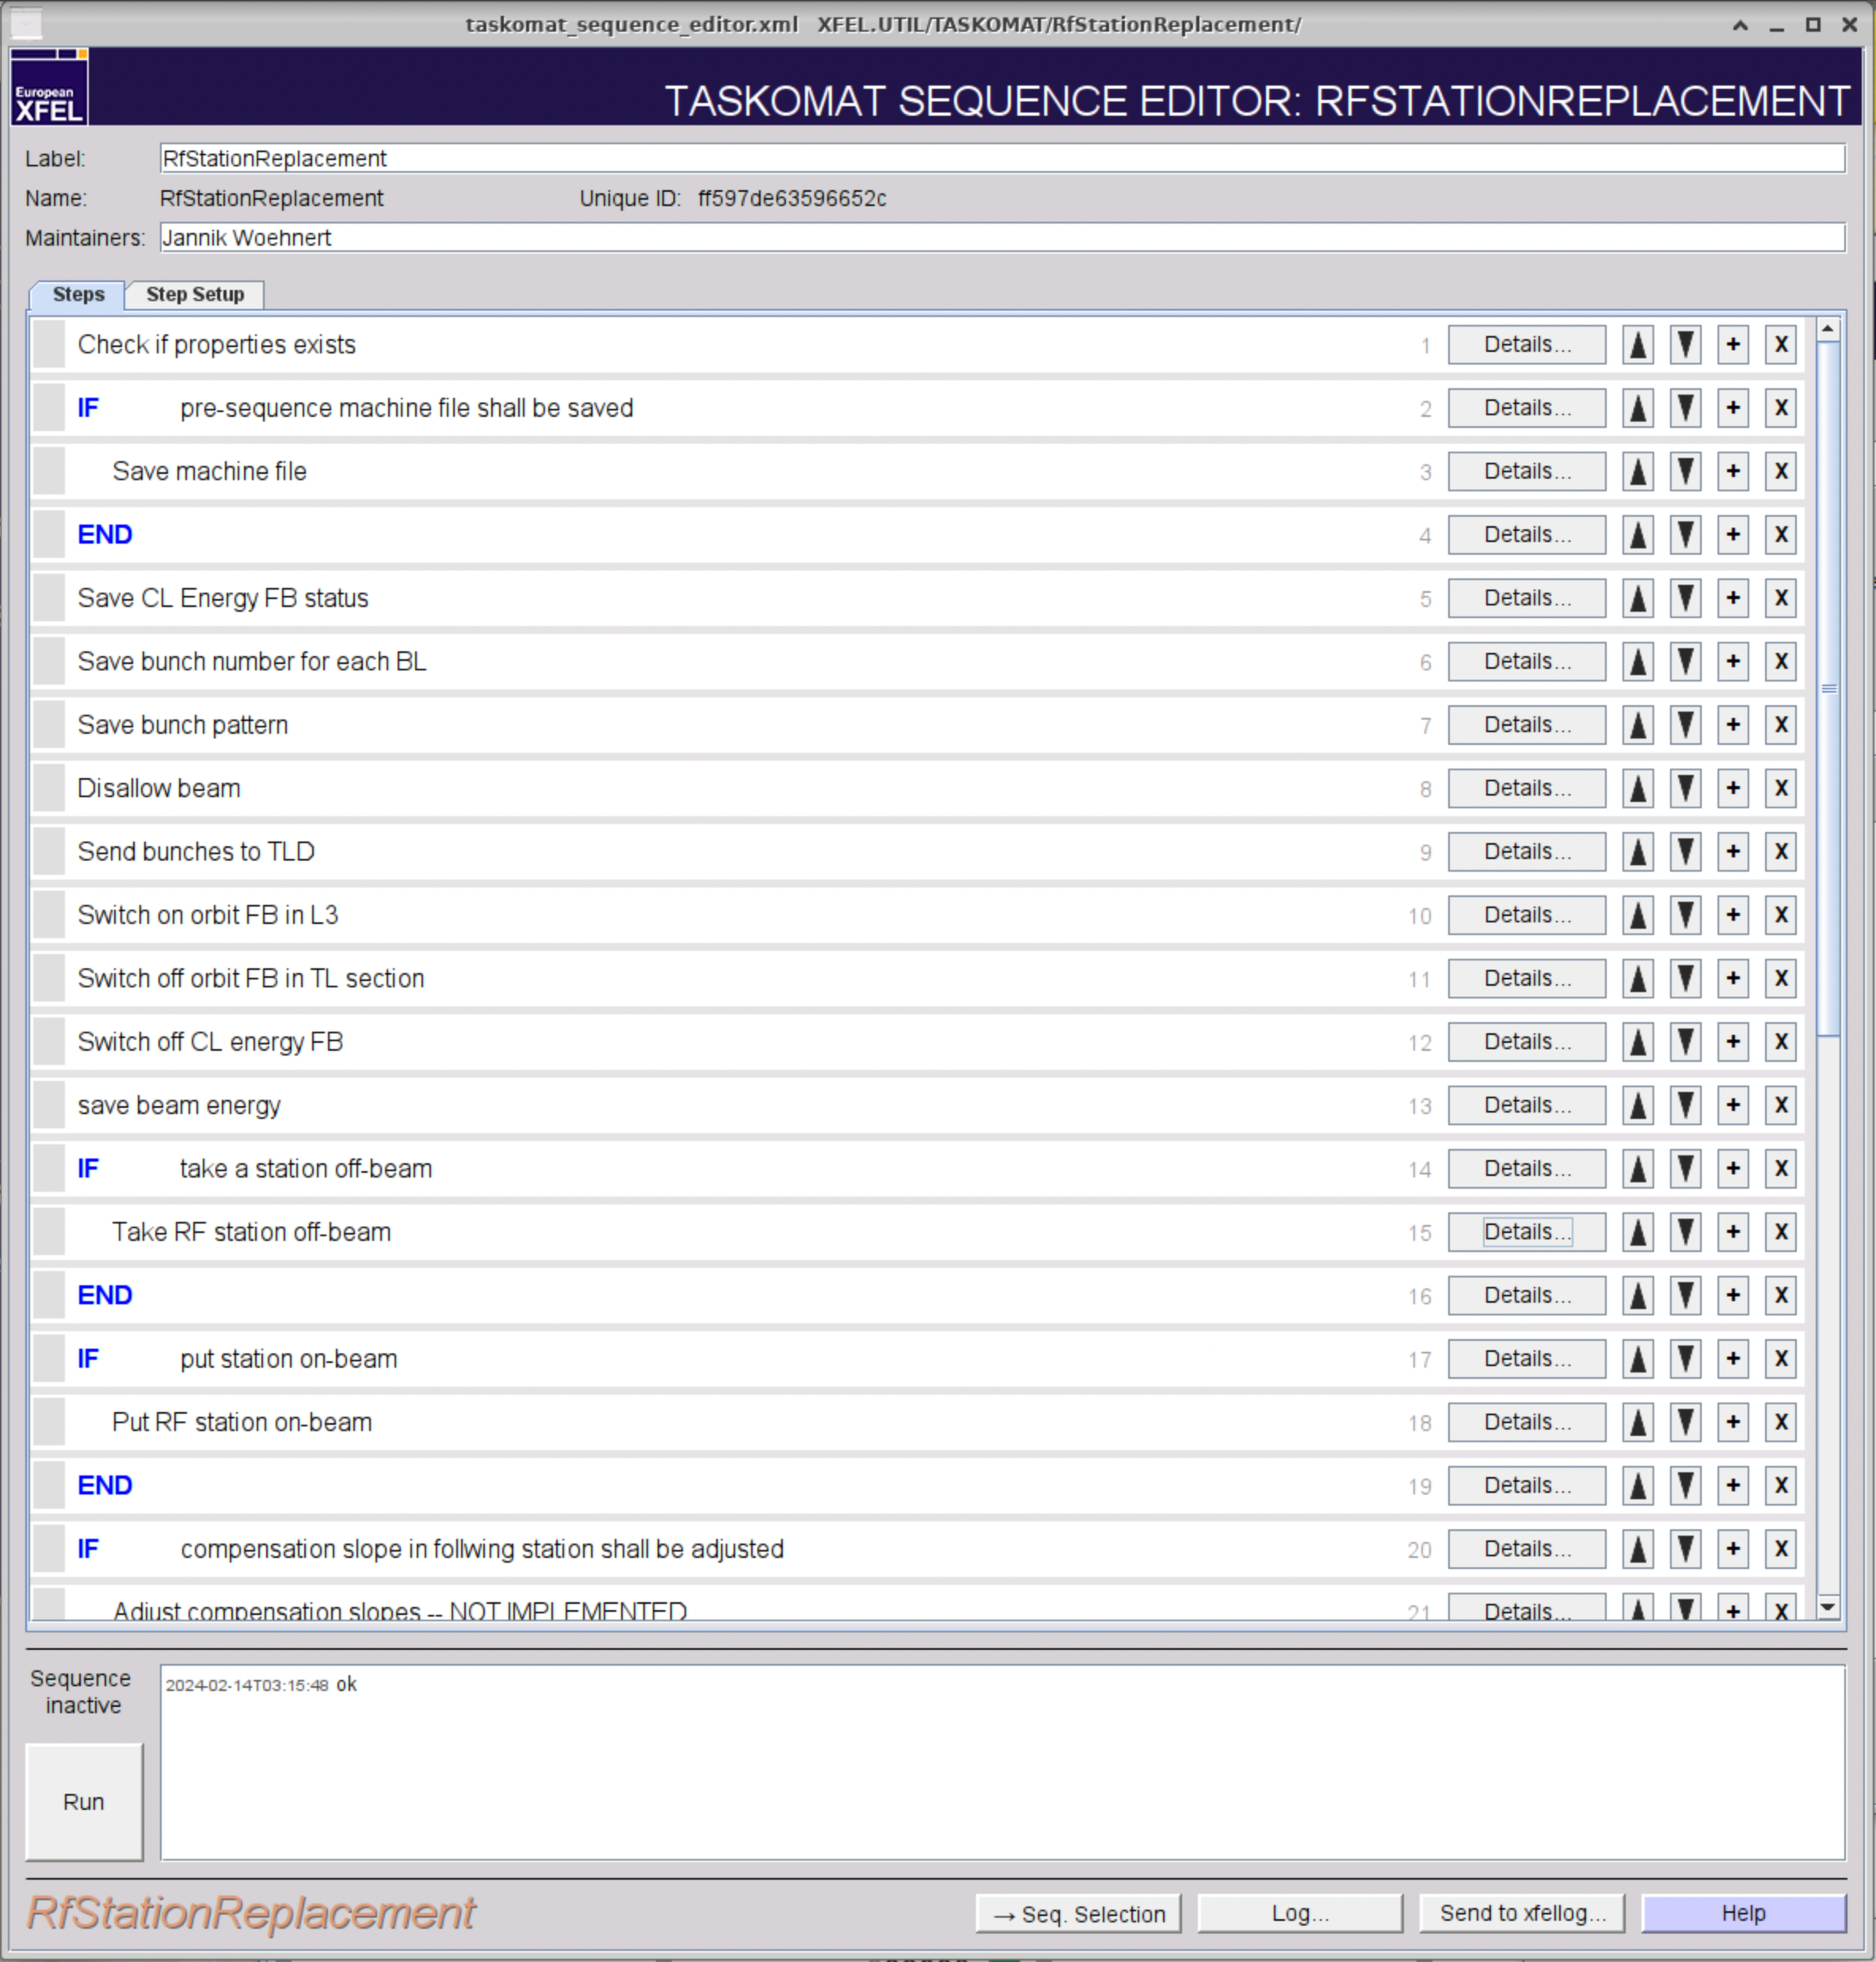
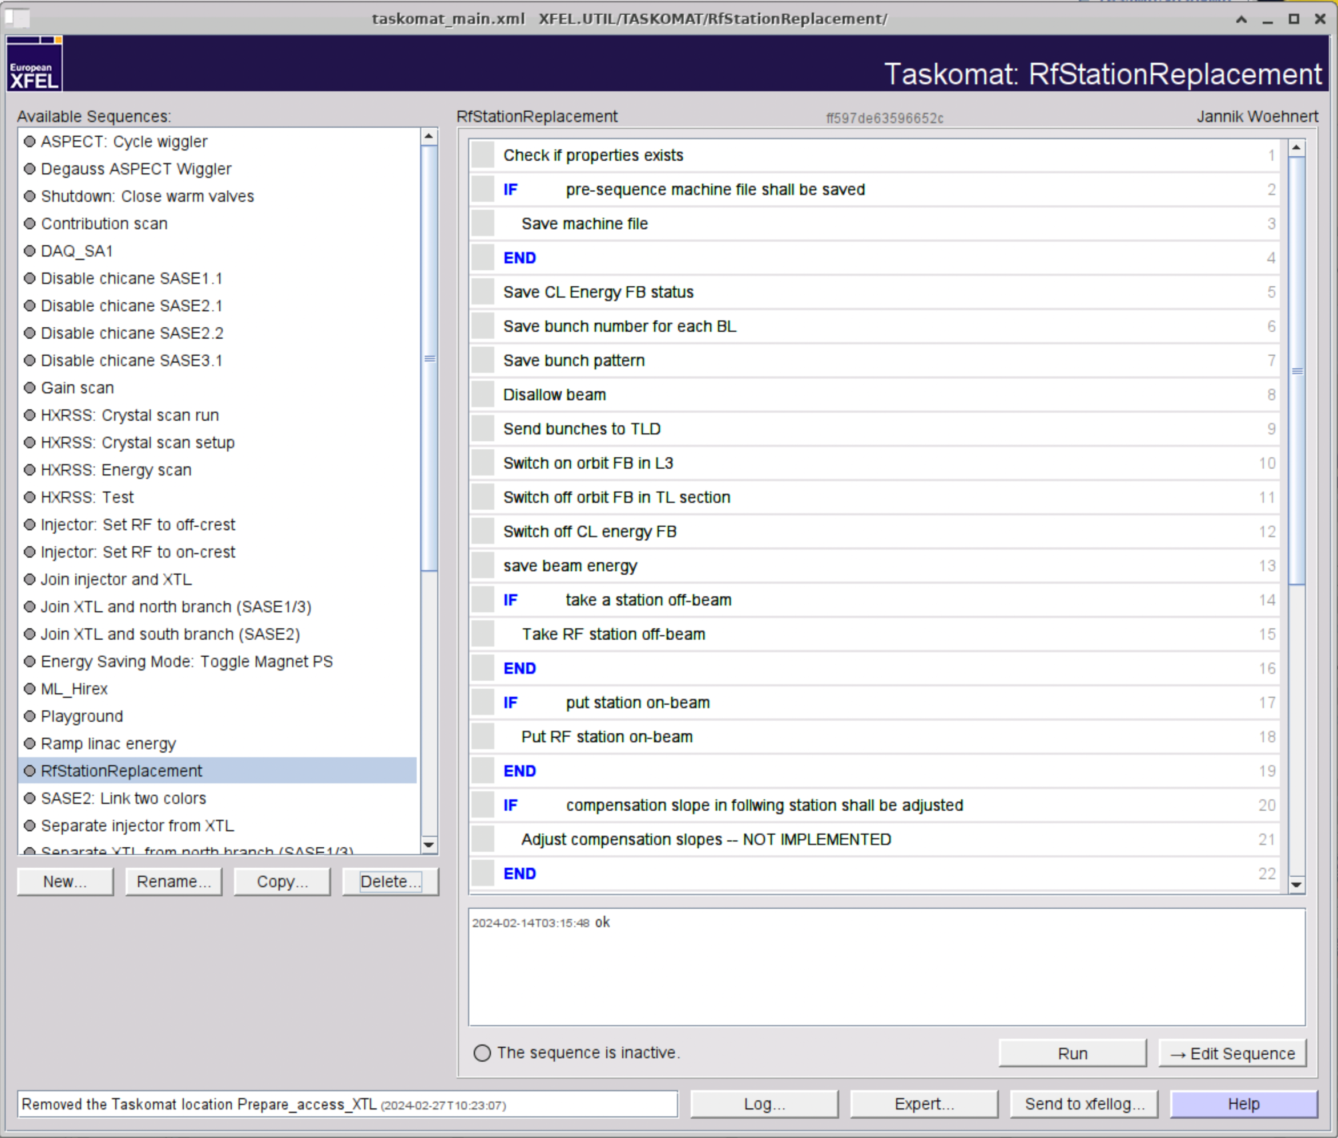
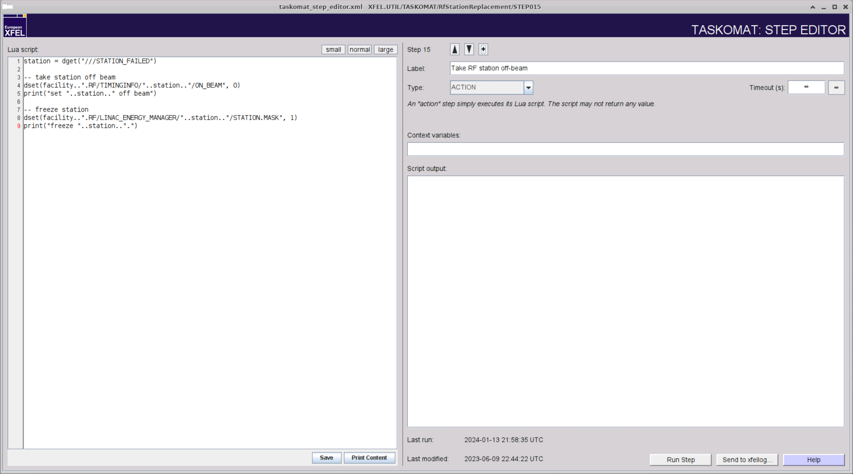
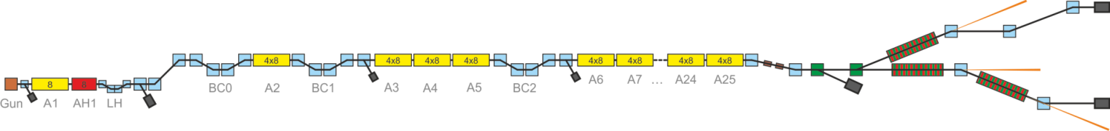
Automation of sequences
Example for a Taskomat sequence
Modify individual steps
Lua-Script
Select sequence on the left
Individual steps are shown on the right
Access to the individual sequence steps

Slide 28
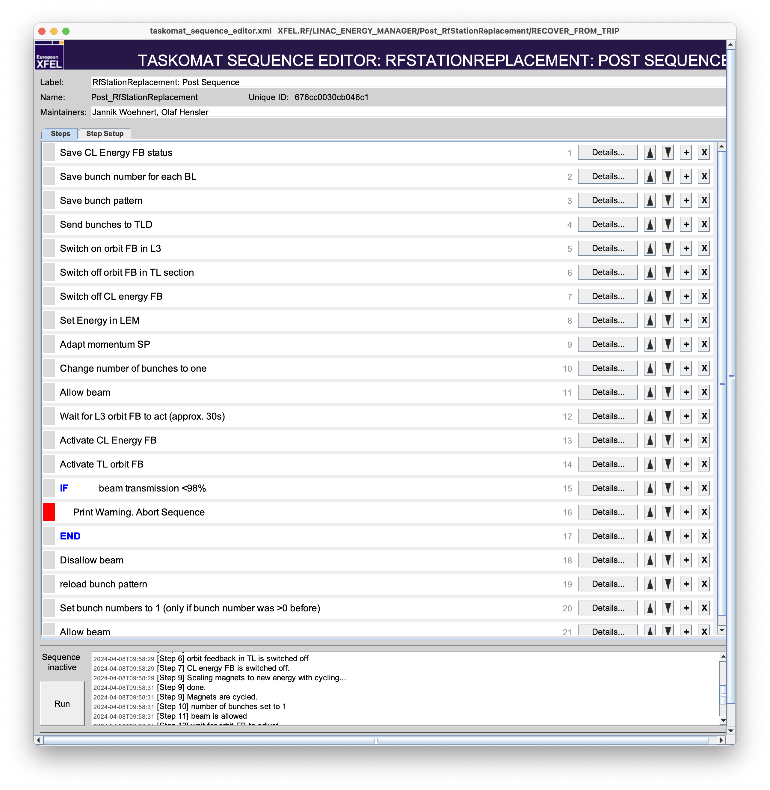
Taskomat example: RF station failure in the main linac
The finite state machine (FSM) of the relevant RF station typically recovers the operation mode within less than 3 minutes.
If the FSM fails, the RF station in question will be replaced by a spare station if available.
Then the following Taskomat sequences starts (selection of the most important steps)
Save machine status
Recover the electron beam energy with the spare station, or distribute the missing gradient to all other stations.
Adjust the magnet strength to the different beam energy steps in the main linac.
Allow 1 bunch to the first main dump (distribution section).
Run the trajectory feedbacks to compensate different coupler kicks from the RF stations.
Verify transmission to the dump.
Reload previous bunch pattern (distribution to the individual undulator beamlines).

Slide 29
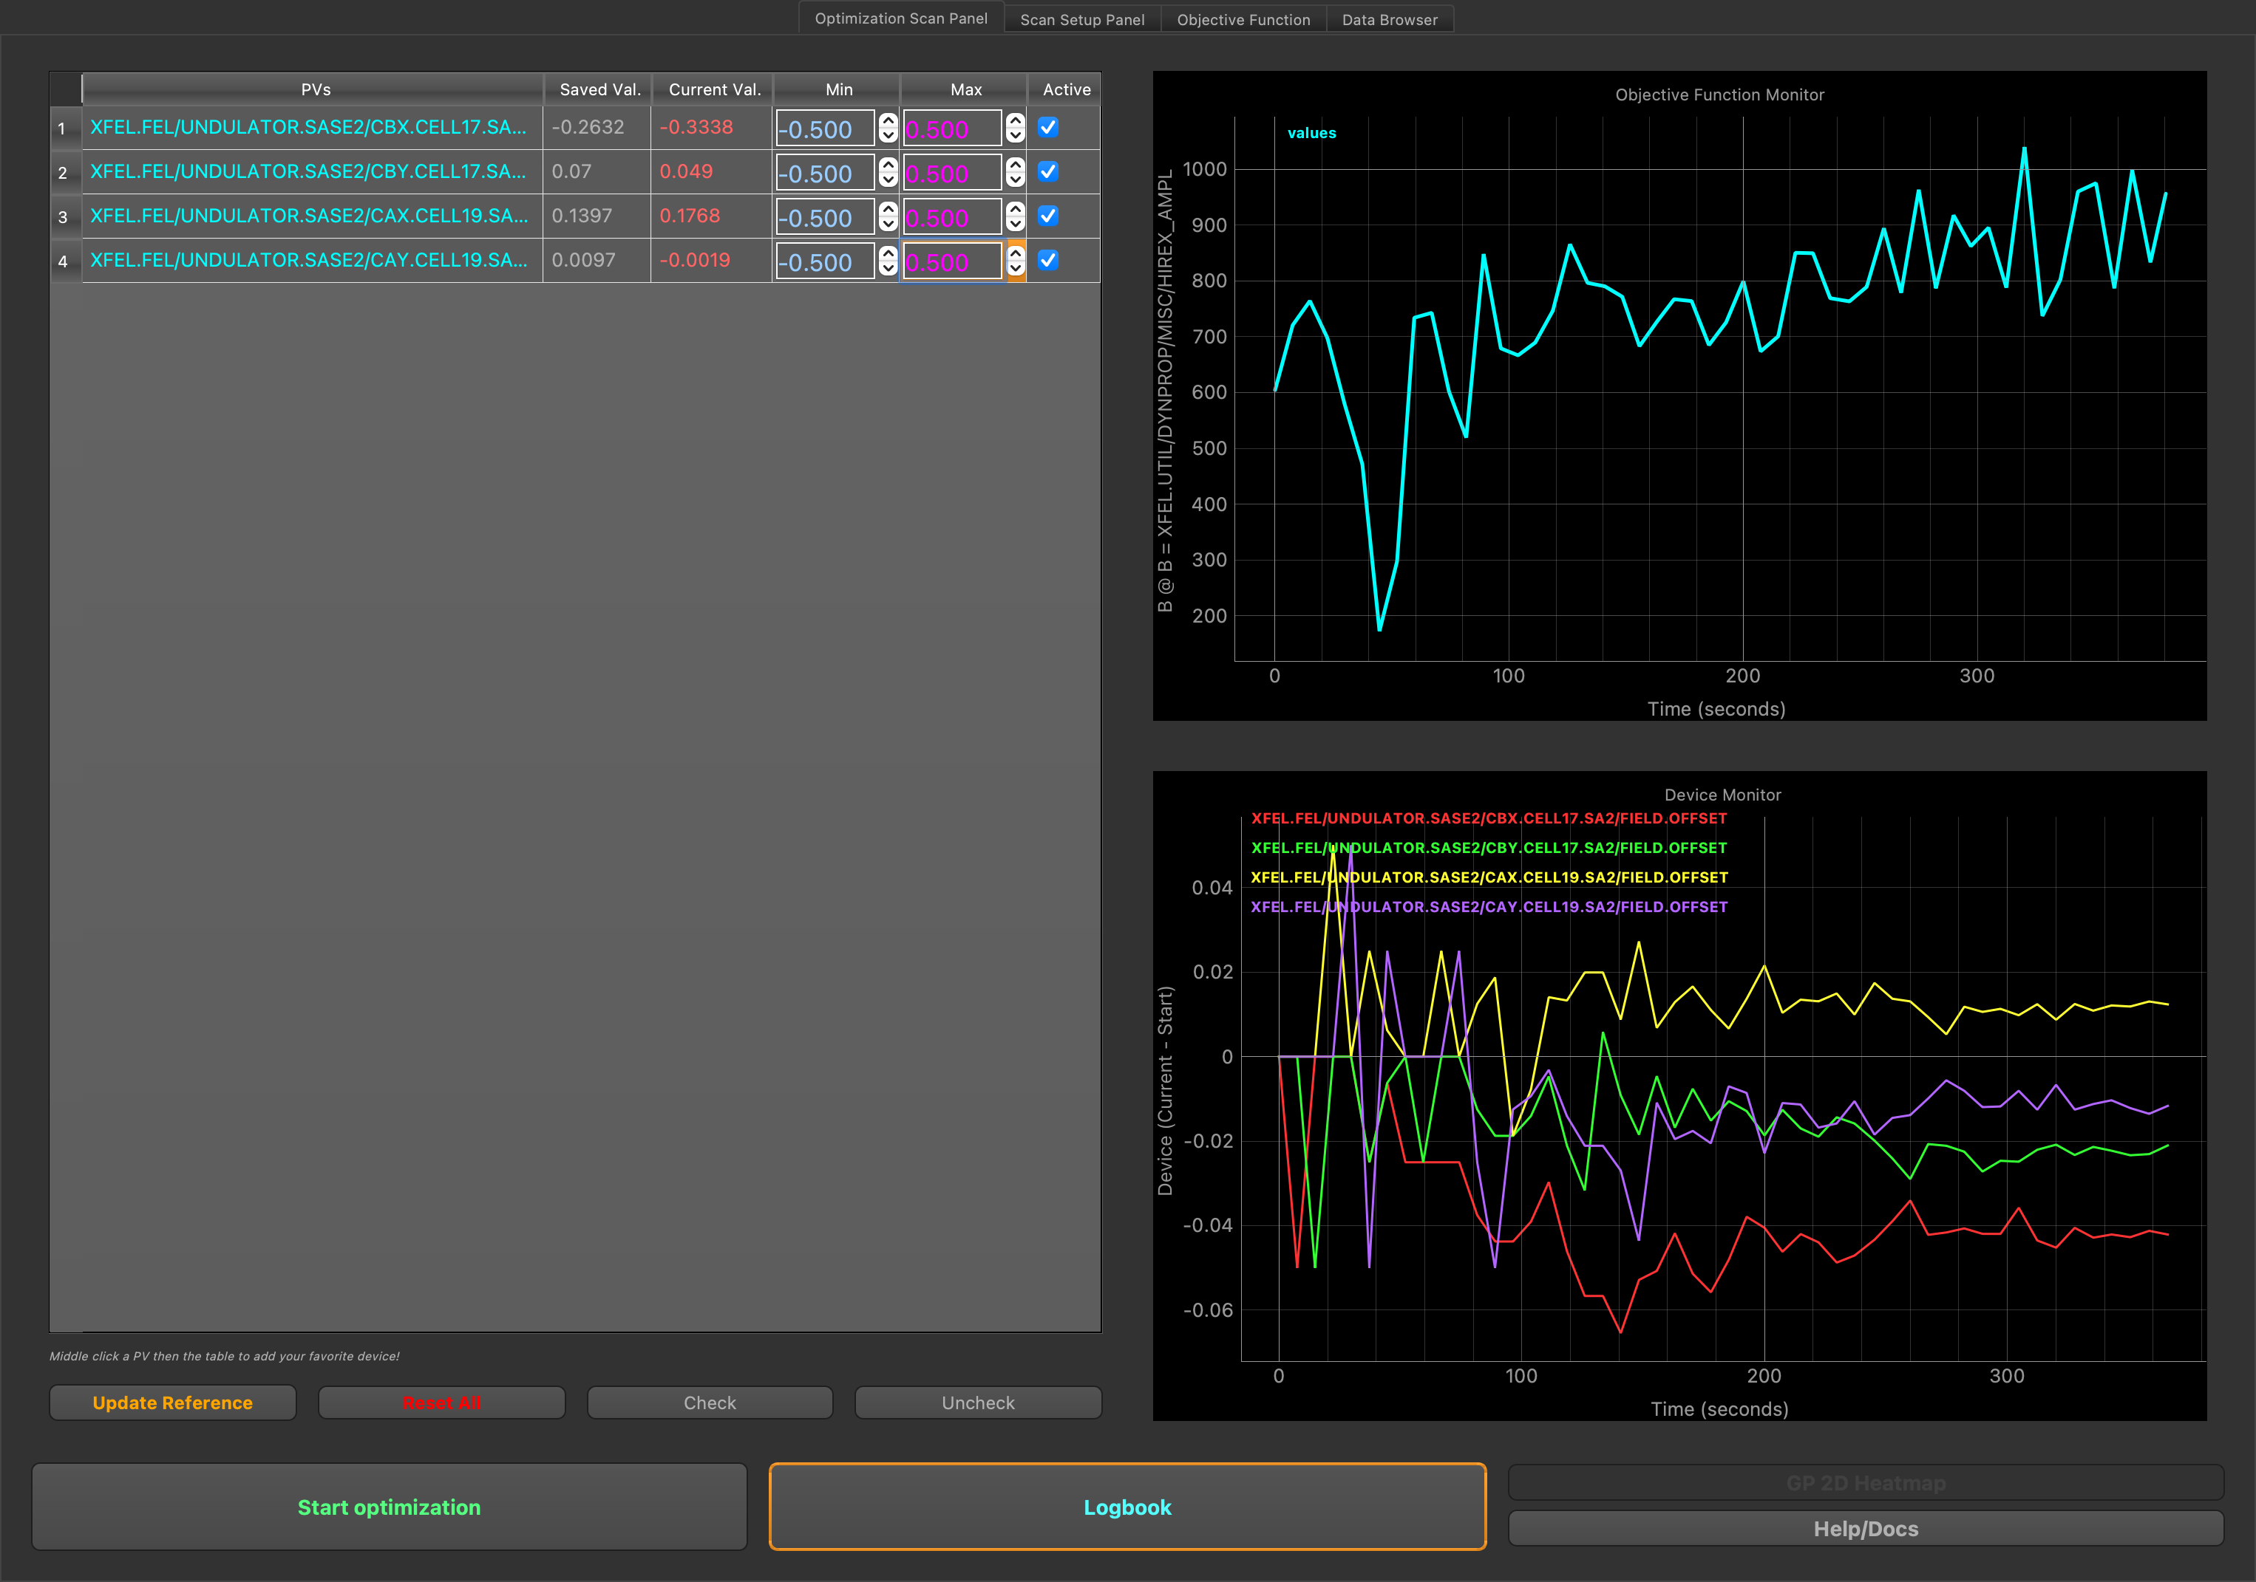
Generic optimizer
Drag and drop DOOCS properties for actuators and monitors.
Many presets are available for standard tuning.
Optimization routine can be freely programmed and started e.g. for dispersion minimization.
A selection of matching quadrupoles upstream of an undulator beamline
Pulse intensity during the optimization progress
Variation of the magnet’s strength for optimization

Slide 30

Generic optimizer
Drag and drop DOOCS properties for actuators and monitors.
Many presets are available for standard tuning.
Optimization routine can be freely programmed and started e.g. for dispersion minimization.
A selection of matching quadrupoles upstream of an undulator beamline
Pulse intensity during the optimization progress
Variation of the magnet’s strength for optimization
Prepared standard optimization setups

Slide 31


Generic optimizer
Drag and drop DOOCS properties for actuators and monitors.
Many presets are available for standard tuning.
Optimization routine can be freely programmed and started e.g. for dispersion minimization.
Script for dispersion measurement, carried out at each optimization step
A selection of matching quadrupoles upstream of an undulator beamline
Dispersion correction in the injector
Pulse intensity during the optimization progress
Variation of the magnet’s strength for optimization
Prepared standard optimization setups

